Slide 1


NOTE: Many slides contain animations that only run in Slideshow mode!
Actinic mask imaging:
Recent results and future directions
from the SHARP EUV Microscope
Kenneth A. Goldberg
Lawrence Berkeley National Laboratory
Please do not reproduce without permission and attribution.
M. Benk, A. Wojdyla, I. Mochi, S. Rekawa, A. Allezy, M. Dickinson,
C. Cork, J. Macdougall, W. Chao, D. Zehm, P. Naulleau, A. Rudack
KAGoldberg@lbl.gov SPIE Advanced Lithography, 2014 February 2014
NOTE: Many slides contain animations that only run in Slideshow mode!
The speaker’s notes (below) contain information about each slide
Notes:
SHARP is a SEMATECH-funded EUV Mask imaging project at Lawrence Berkeley National Laboratory.

Slide 2
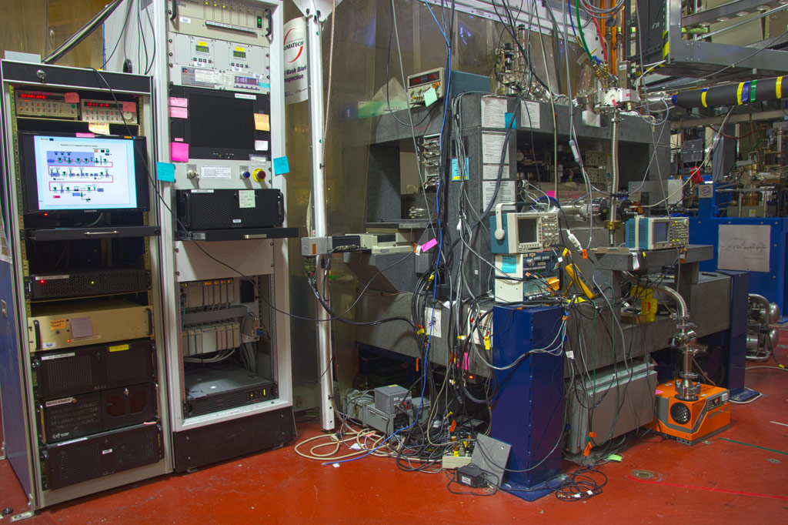

AIT
2004 – 2012
Notes:
The SHARP tool replaced the AIT, which ran for about 8 years and was decommissioned in Fall 2012.

Slide 3
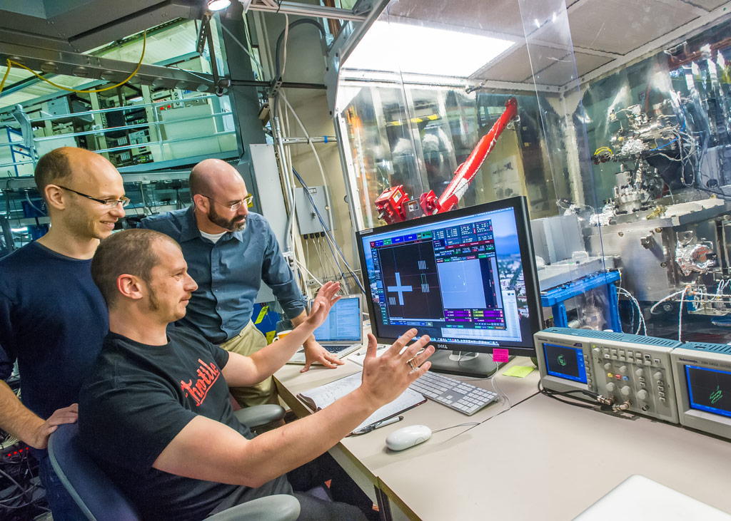
SHARP
June 2013–
Notes:
The new tool operates on a similar principle, but it’s a ground-up re-design and it’s vastly superior

Slide 4
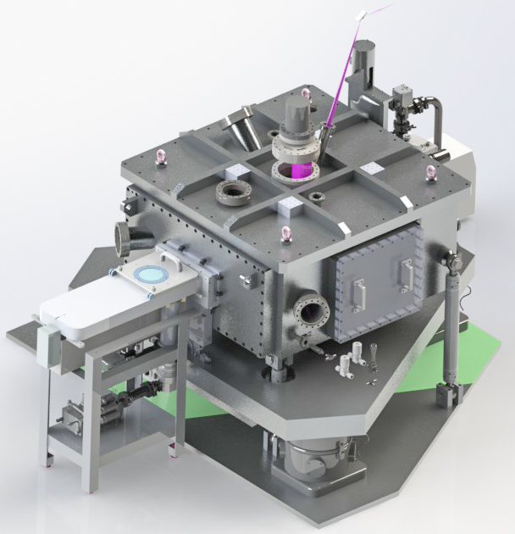

Source: Synchrotron
Optics: Mirrors &
Zoneplate-lenses
4×NA: 0.25–0.625
σ: Programmable
Nav: Full-mask xy
Speed: ~8 series/hr
Notes:
This is SHARP. Let’s talk about its most important features…. It’s a research prototype, not a commercial tool, and it’s designed for the special properties of narrow bandwidth and narrow divergence angles of the synchrotron beamline source. With the perspective of 8.5 months of running SHARP for industry users, I’m going to talk about (1) how well the coherence control is working, and how we use it, (2) I’ll show a selection of user data, and then I’ll talk about (3) the things we’re working on to improve the tool.

Slide 5
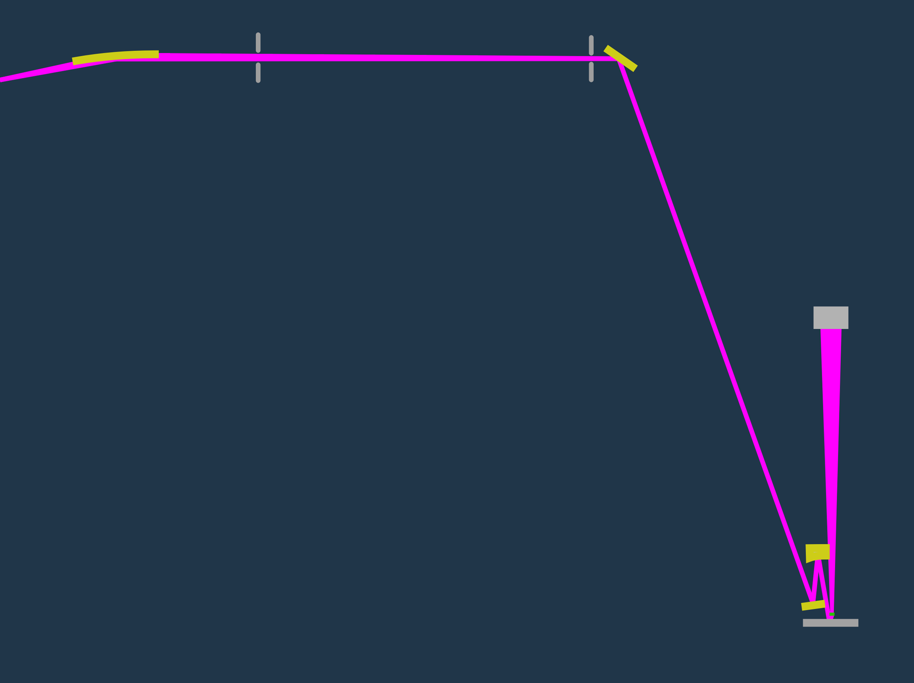

KBy
M_{A}
beamline
focus
CCD
0.45 m
M_{C}
Not to scale
M_{B}
Mask
Notes:
The beamline comes to an intermediate focus at the first mirror of the 3-mirror illiuminator. That spot is re-imaged with 10x demagnification down onto the mask. A tiny zoneplate lens catches the reflected light and sends a high-magnification EUV image up to the CCD camera.

Slide 6

EUV Zoneplate
& Visible-light
Imaging Optics

Slide 7
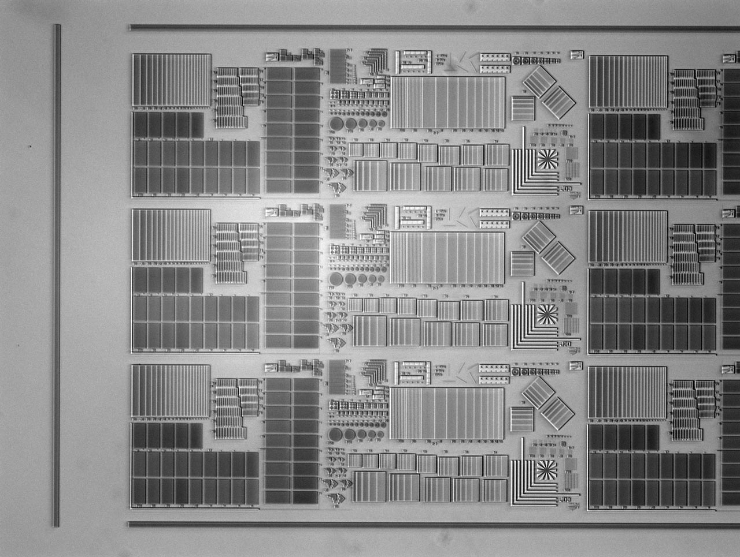
Visible-light microscope: Brightfield
200
µm
Notes:
To speed up our navigation, SHARP has a visible-light microscope with a 1.5 mm field of view. We can operate in Brighfield…

Slide 8
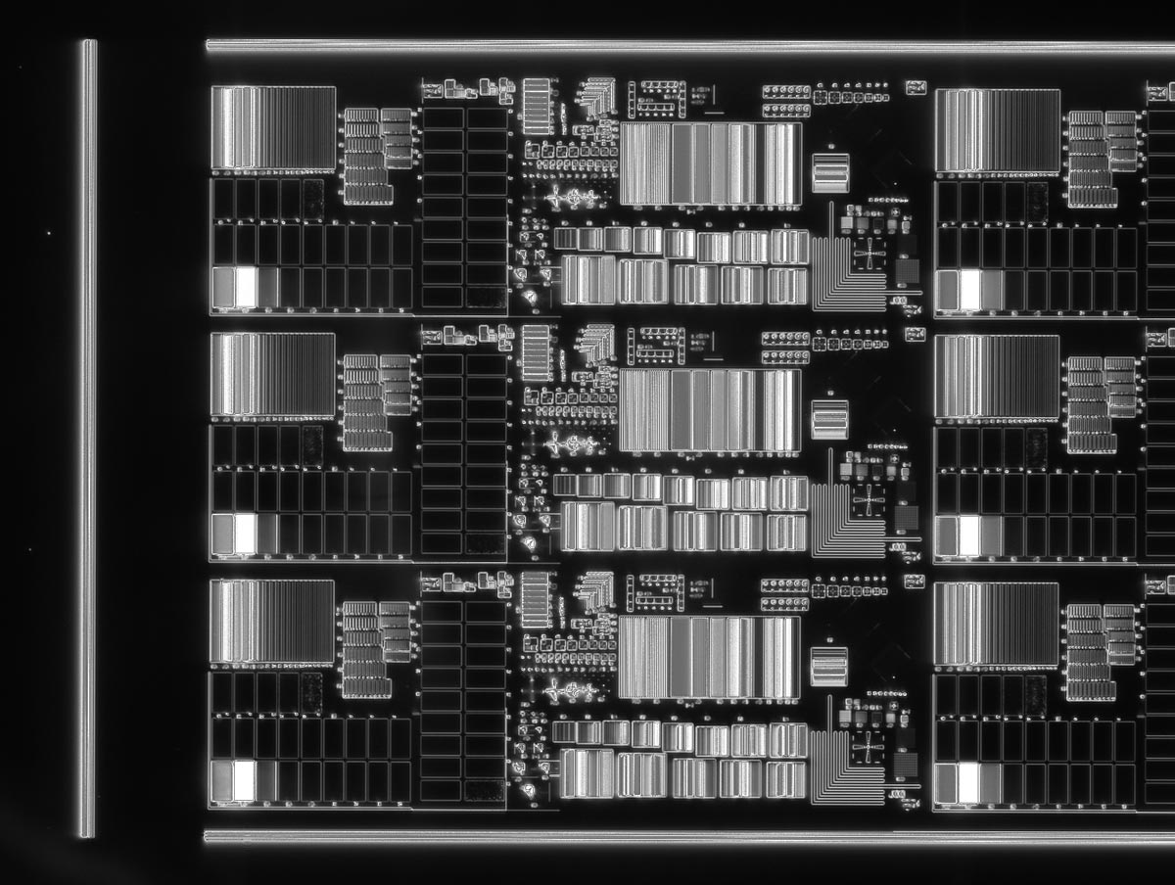
Visible-light microscope: Darkfield
200
µm
Notes:
and darkfield modes for sensitivity to micron-scale features.

Slide 9
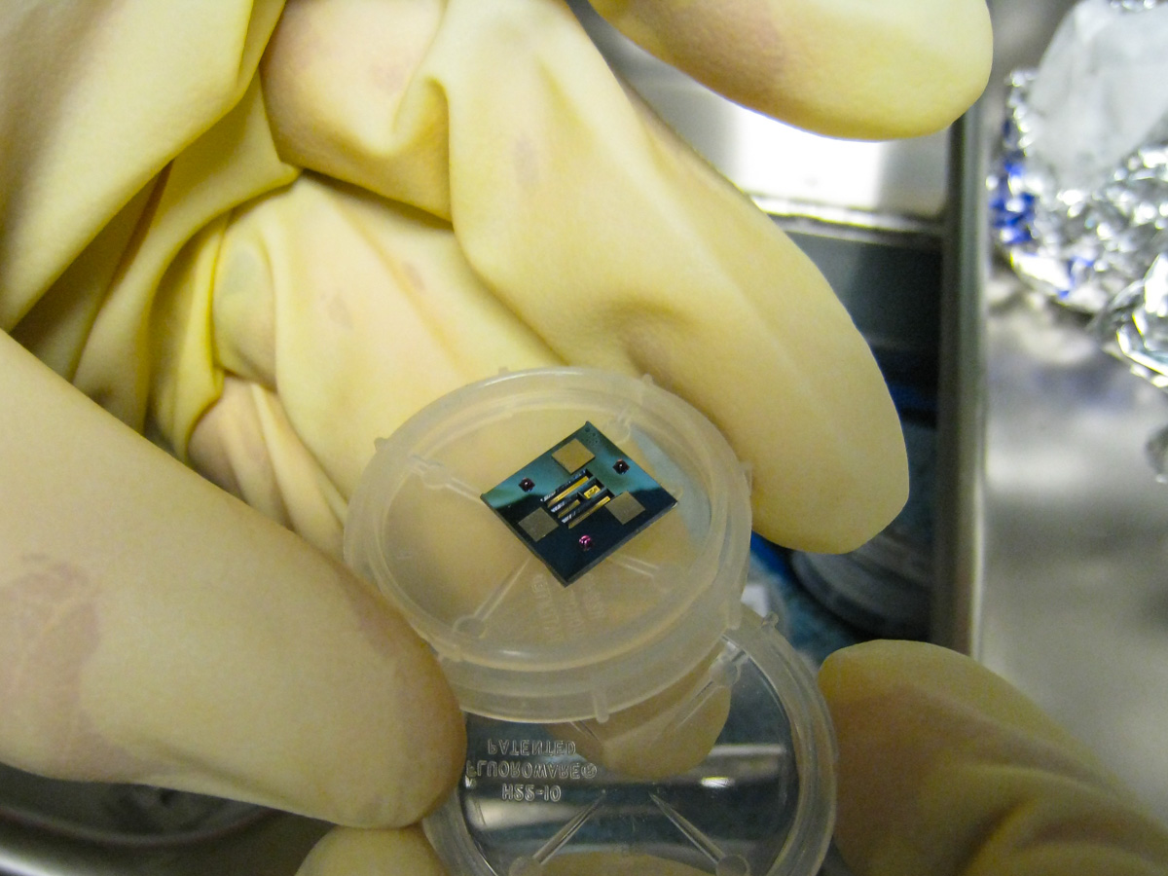
zoneplate
lenses
Notes:
We use e-beam lithography to pattern the zoneplates—The lenses are so small, you can have
an array of 70 lenses in the space of a few mm. The other thing that’s important is alignment.
We use a ball-and-groove kinematics to hold the lenses in the right place.

Slide 10
Notes:
What you see here are free-standing Au or Ni membranes, 3 magnetic pads, and 3 ruby balls for kinematic positioning.

Slide 11
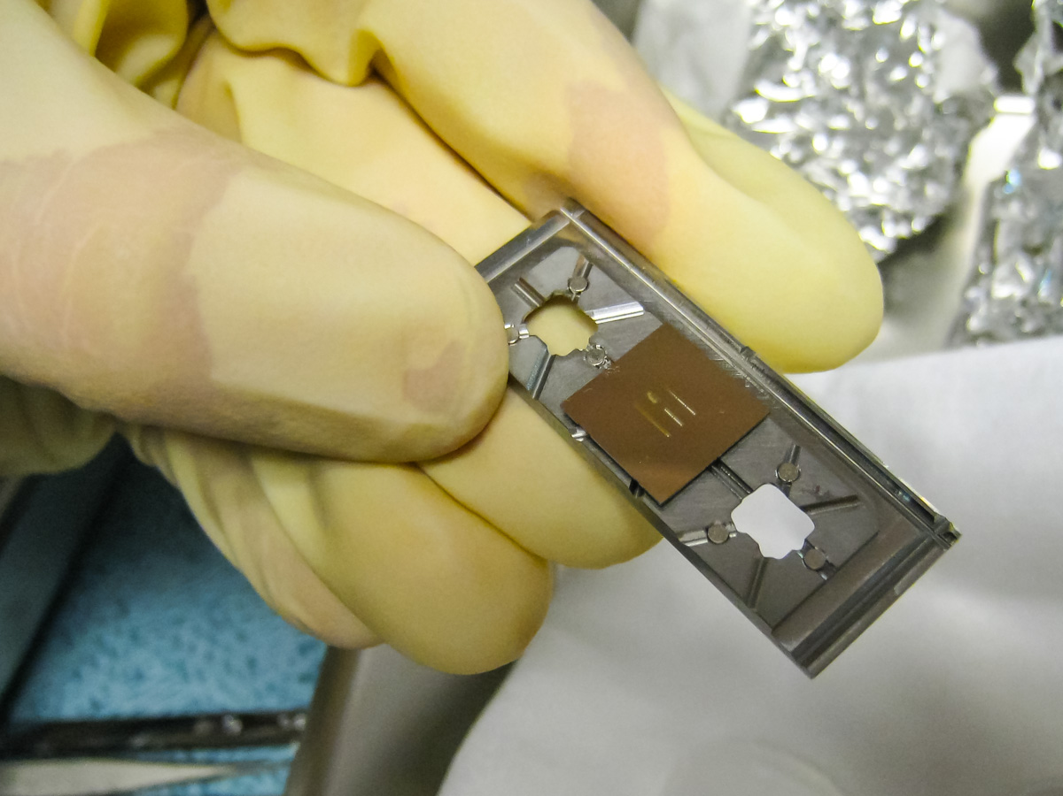
Notes:
The zoneplate holder has complementary kinematics, and space for 3 chips, with either redundant or different lens arrays.

Slide 12
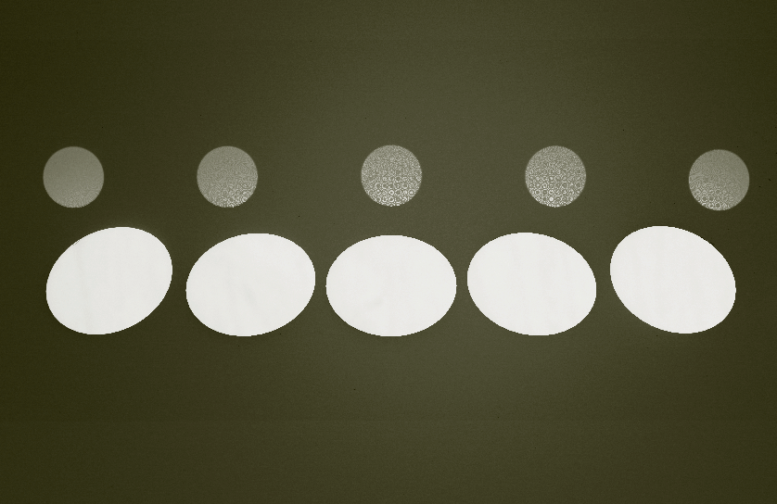
0.25 4xNA zoneplates
–25°
0°
+25°
100 μm
Notes:
Here’s a close-up of the zoneplates and their windows, which are actually holes in the absorber membrane.

Slide 13
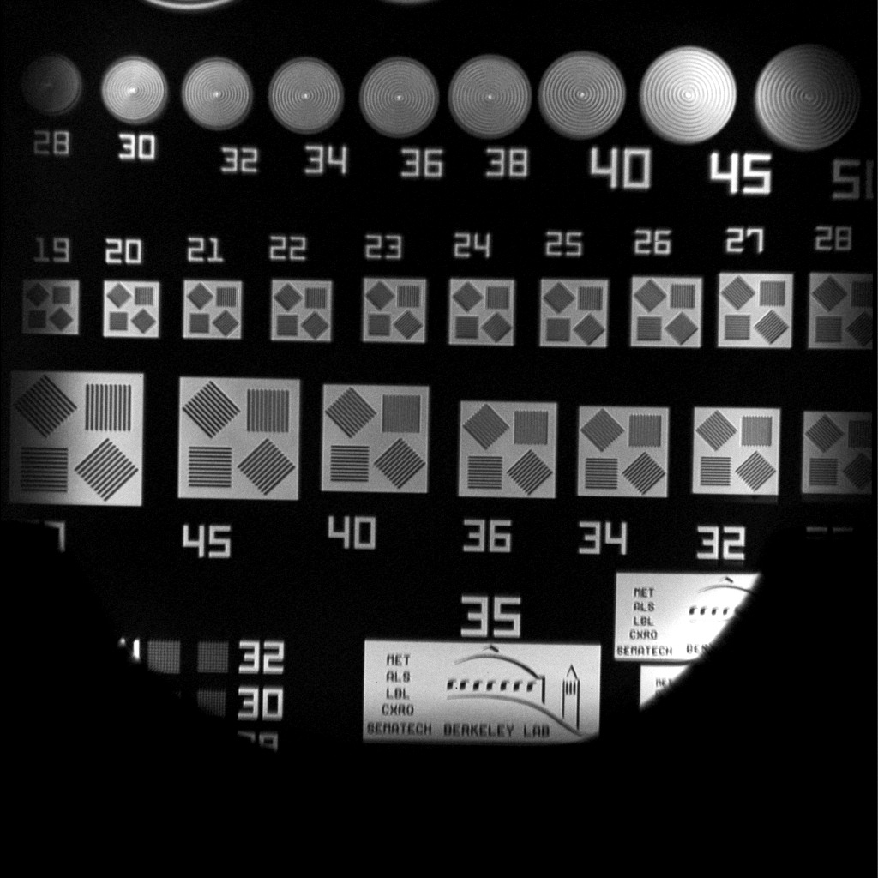
Low-magnification EUV for navigation (300×)
~90 µm
field of
view
5 µm
MET10_Ken-130816-0024-0001-b2_scaled
Notes:
We even have a low-magnification zoneplate. Here the field is close to 90 microns.

Slide 14
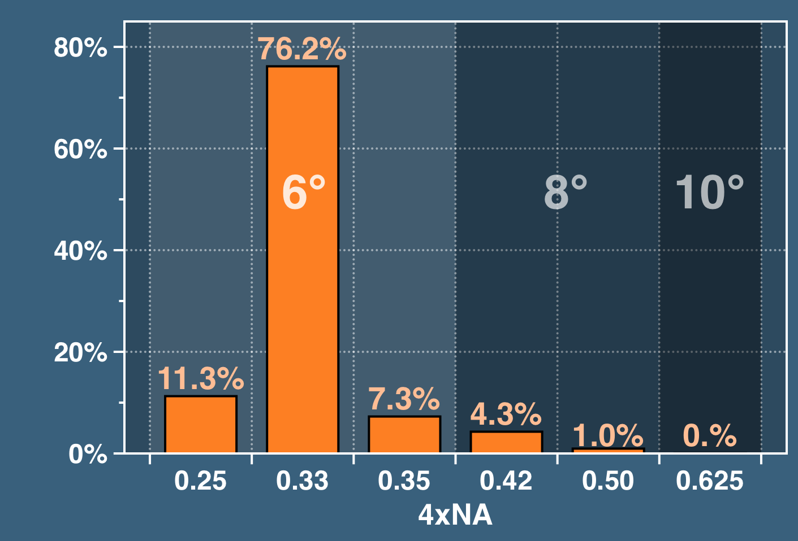
Users’ imaging-NA preferences
Requests
0.04%
Notes:
After 8.5 months, 70 thousand images, we can look at what zoneplates the users request. There’s a vast preference for the 0.33-NA lens with 6° incidence. In the future, this may change.

Slide 15
Lossless
Coherence-control
Illuminator

Slide 16
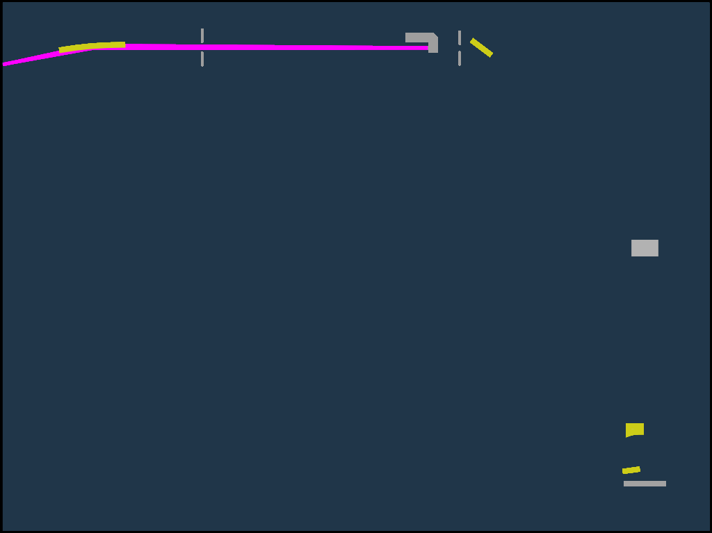
KBy
M_{A}
coherence
control
beamline
focus
CCD
two active elements
0.45 m
uniformity
control
M_{C}
Not to scale
M_{B}
Mask
Notes:
There are two active elements. The MA mirror scans the illumination angle and generates arbitrary, fully programmable partial coherence. MB is a flat, turning mirror. And MC is an off-axis ellipsoid that re-images the beam onto the mask. MC shakes ever so slightly, provding a way to paint out the beam uniformity on the scale of microns to tens of microns.

Slide 17
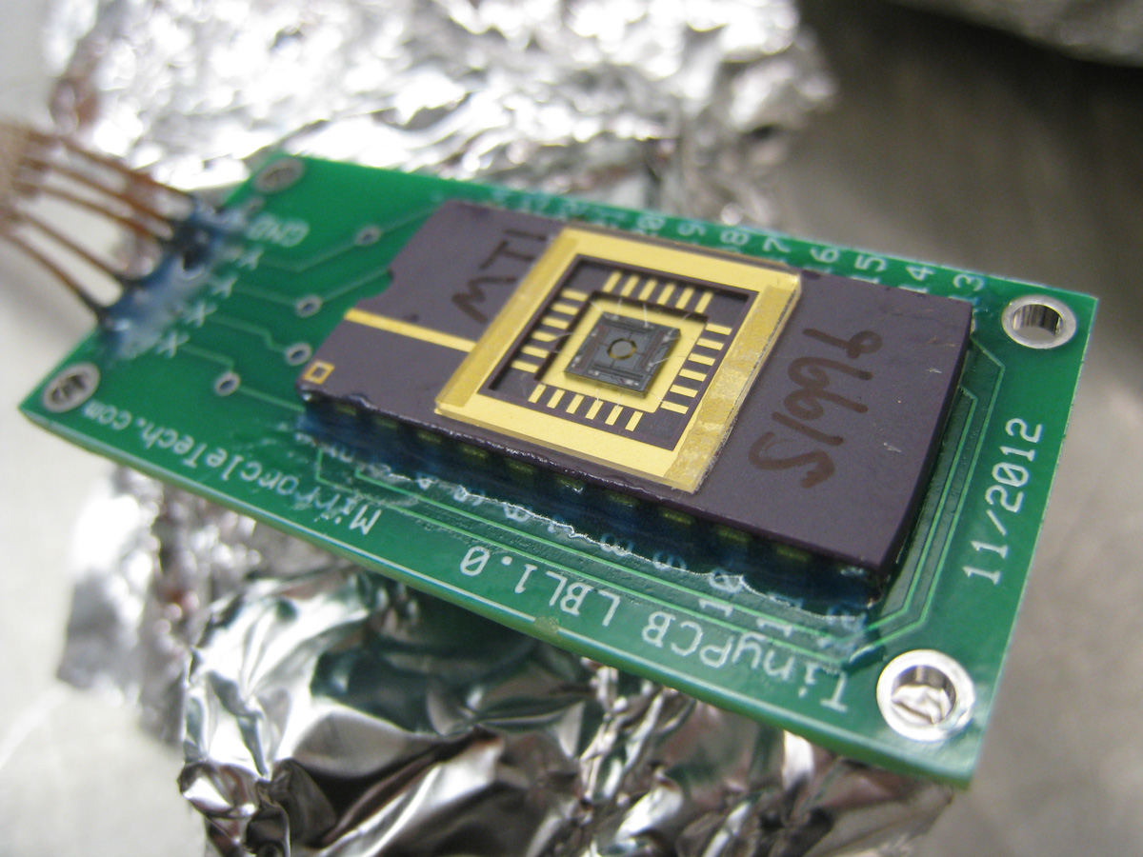
SHARP’s 2-axis
MEMS mirror
Mirrorcle Technologies
Notes:
MA is actually a ML coated MEMS mirror, with a 1 mm diameter.

Slide 18
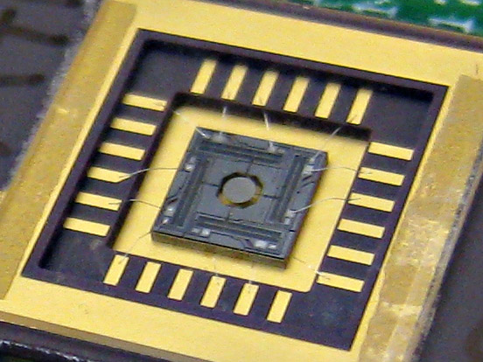
SHARP’s 2-axis
MEMS mirror
1 mm
Notes:
Here it is.

Slide 19
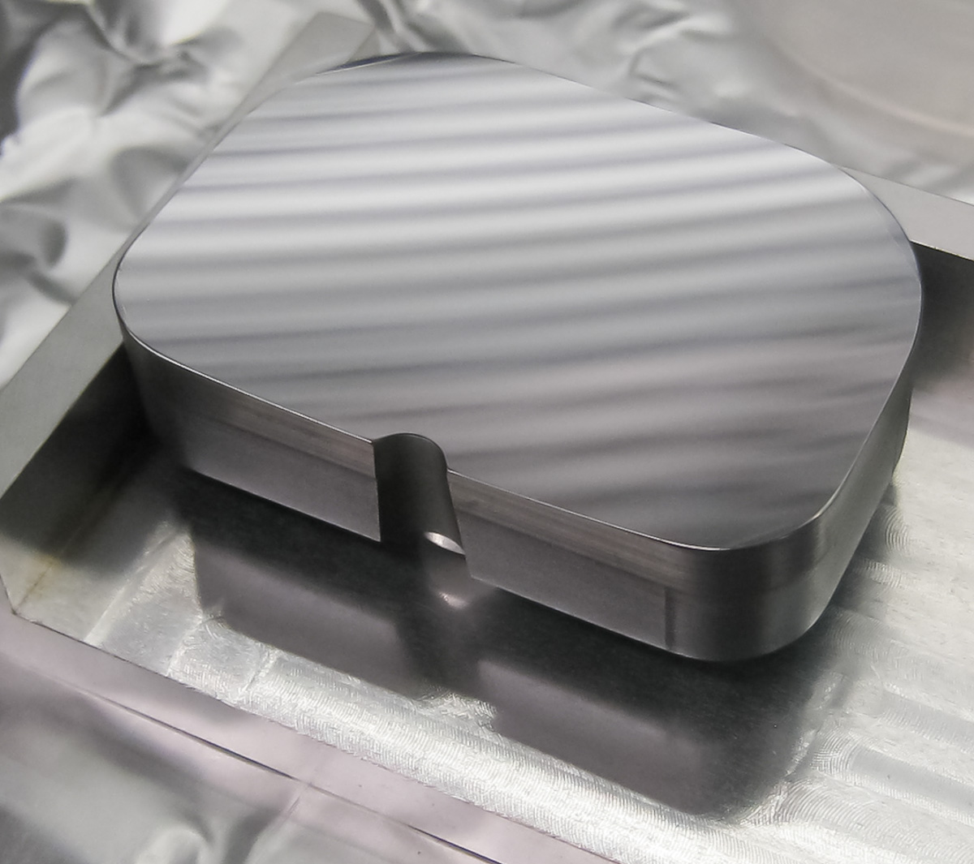
SHARP
Condenser
L-3 Tinsley
Notes:
MC has a graded ML coating, and can handle off-axis rays up to 19 degrees. The notch allows the vertical rays to reach the CCD camera.

Slide 20
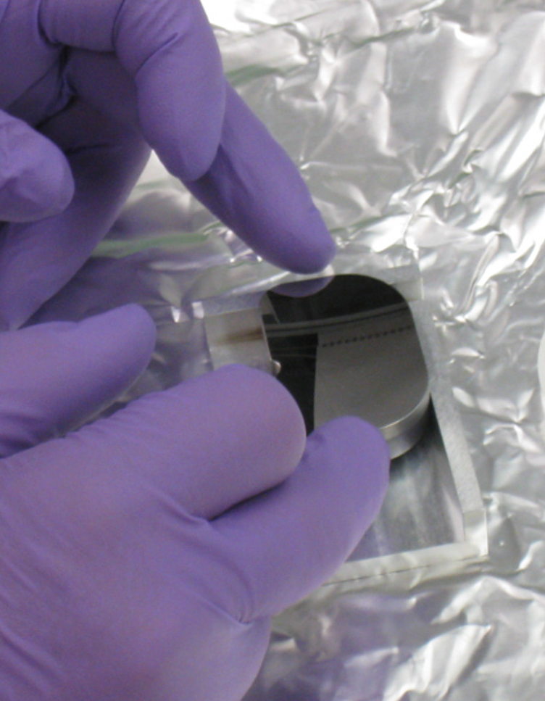
Notes:
You can get a sense of the scale of the mirror here. It’s about 50 mm wide.

Slide 21







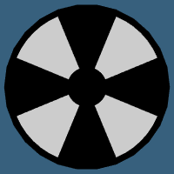






Users’ illumination pupil-fill preferences
Notes:
Here are the illumination pupil fill patterns that the users have requested. You can see disk, dipole, quasar, cross-pole, and various annular patterns.

Slide 22
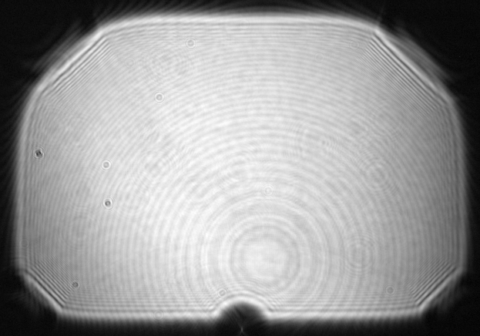
SHARP condenser
Notes:
We achieve those patterns losslessly as follows. Here’s a visible-light image of the illuminator pupil. Think of this as a map of the illumination angles.

Slide 23
SHARP condenser
6° CRA
0.35 4xNA
Notes:
Here’s the footprint subtended by a sigma=1 beam at 6° 0.35

Slide 24
SHARP condenser
8° CRA
0.50 4xNA
Notes:
etc.

Slide 25
SHARP condenser
10° CRA
0.625 4xNA
Notes:
etc.

Slide 26
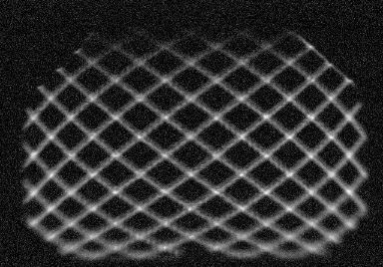
Coherence Control: Pupil Fill Patterns
filling the illuminator
LISSAJOUS
Notes:
Using the MEMS mirror we scan out angluar patters in time, filling the pupil several times in each exposure.

Slide 27
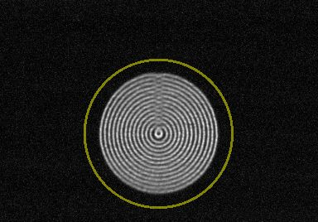
Coherence Control: Pupil Fill Patterns
0.5-NA 0.8-σ 8° CRA
DISK
Notes:
Here’s a sampling of fill patterns and how we achieve them. All of these images were recorded with a YAG microscope that looks up into the illuminator.

Slide 28
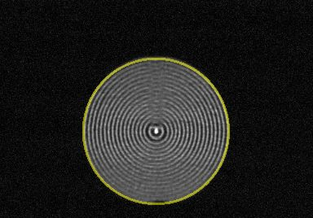
Coherence Control: Pupil Fill Patterns
0.5-NA 1.0-σ 8° CRA
DISK

Slide 29
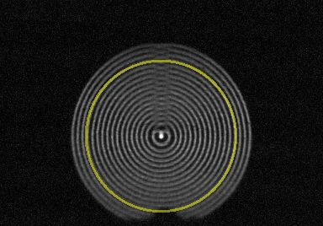
Coherence Control: Pupil Fill Patterns
0.5-NA 1.2-σ 8° CRA
DISK

Slide 30
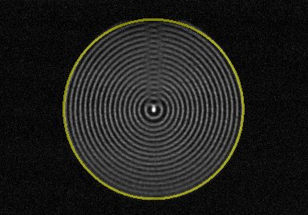
Coherence Control: Pupil Fill Patterns
0.625-NA 1.0-σ 10° CRA
DISK

Slide 31
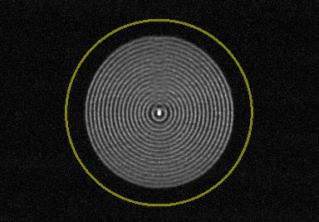
Coherence Control: Pupil Fill Patterns
0.625-NA 0.8-σ 10° CRA
DISK

Slide 32
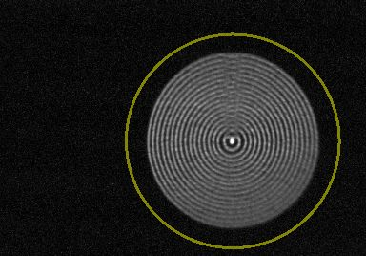
Coherence Control: Pupil Fill Patterns
0.625-NA 0.8-σ 10° CRA +25°
DISK

Slide 33
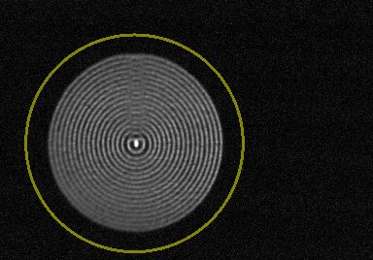
Coherence Control: Pupil Fill Patterns
0.625-NA 0.8-σ 10° CRA –25°
DISK

Slide 34
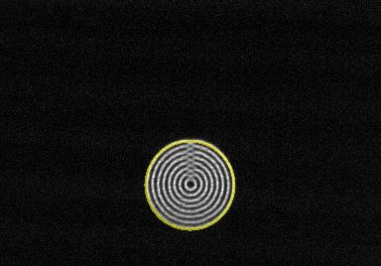
Coherence Control: Pupil Fill Patterns
0.25-NA 1.0-σ 6° CRA
DISK

Slide 35
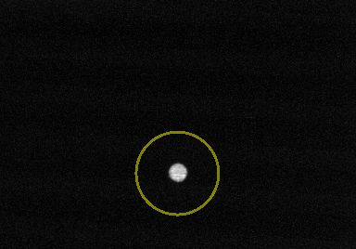
Coherence Control: Pupil Fill Patterns
0.25-NA 0.2-σ 6° CRA
DISK

Slide 36
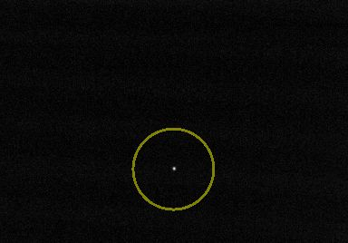
Coherence Control: Pupil Fill Patterns
0.25-NA 0.05-σ 6° CRA
DISK

Slide 37
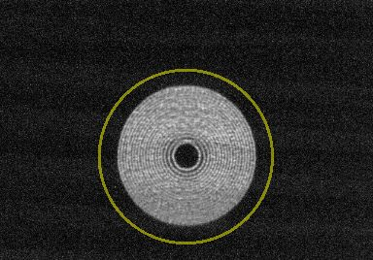
Coherence Control: Pupil Fill Patterns
0.5-NA 0.2–0.8-σ 8° CRA
ANNULAR

Slide 38
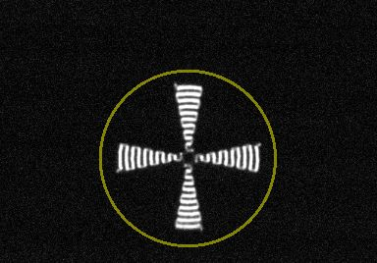
Coherence Control: Pupil Fill Patterns
0.5-NA 0.8-σ 8° CRA
CROSSPOLE (22.5° arc)

Slide 39
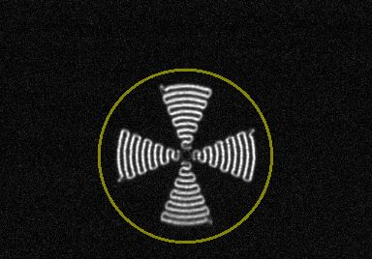
Coherence Control: Pupil Fill Patterns
0.5-NA 0.8-σ 8° CRA
CROSSPOLE (45° arc)

Slide 40
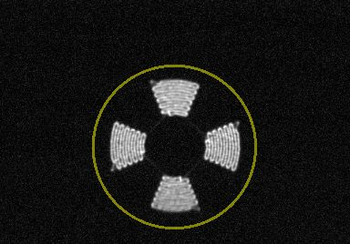
Coherence Control: Pupil Fill Patterns
0.5-NA 0.4–0.8-σ 8° CRA
CROSSPOLE (45° arc)

Slide 41
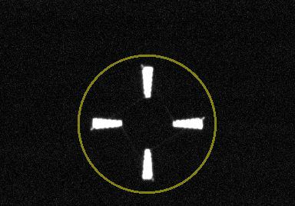
Coherence Control: Pupil Fill Patterns
0.5-NA 0.4–0.8-σ 8° CRA
CROSSPOLE (10° arc)

Slide 42
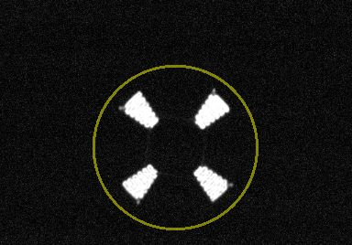
Coherence Control: Pupil Fill Patterns
0.5-NA 0.4–0.8-σ 8° CRA
45° CROSSPOLE (22.5° arc)

Slide 43
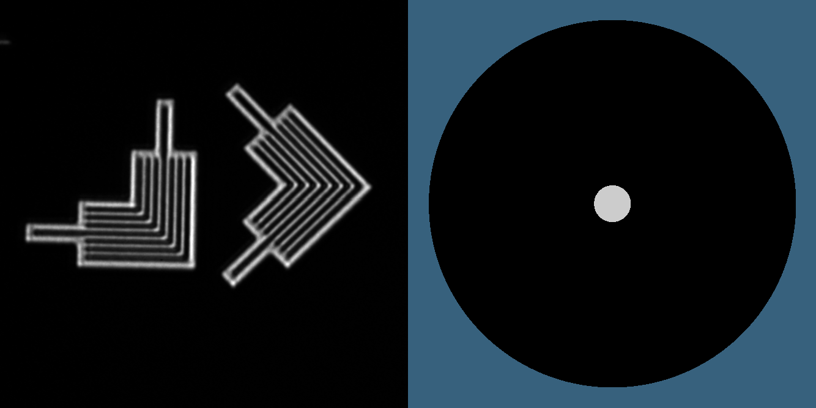
Pupil-fill affects imaging
Elbows, 100-nm CD
0.33 4xNA pupil
Notes:
So we’re synthesizing pupil fills by integrating the signal over time. Start with a coherent illumination of an elbow pattern.

Slide 44
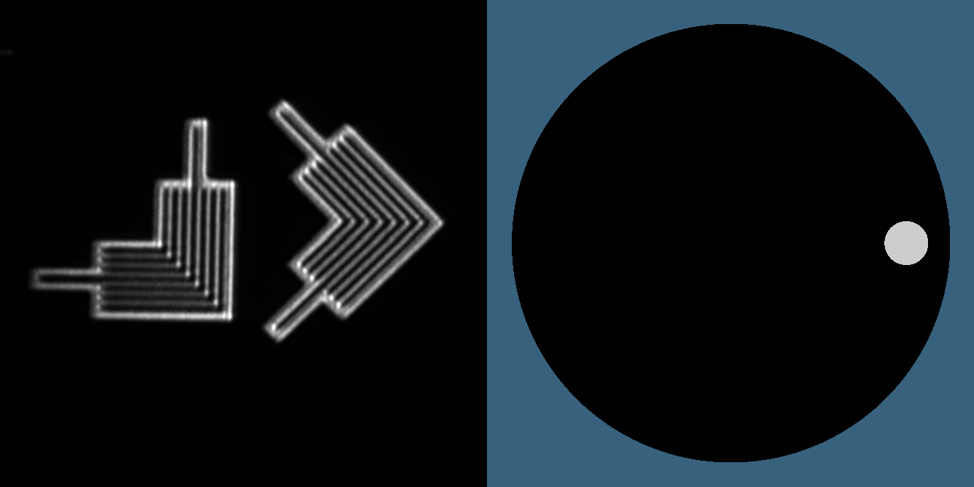
Pupil-fill affects imaging
Elbows, 100-nm CD
0.33 4xNA pupil
Notes:
Then switch to an off-axis monopole. Notice how we lose the contrast in the horizontal lines. A basic understanding of Fourier optics explains how this works.

Slide 45
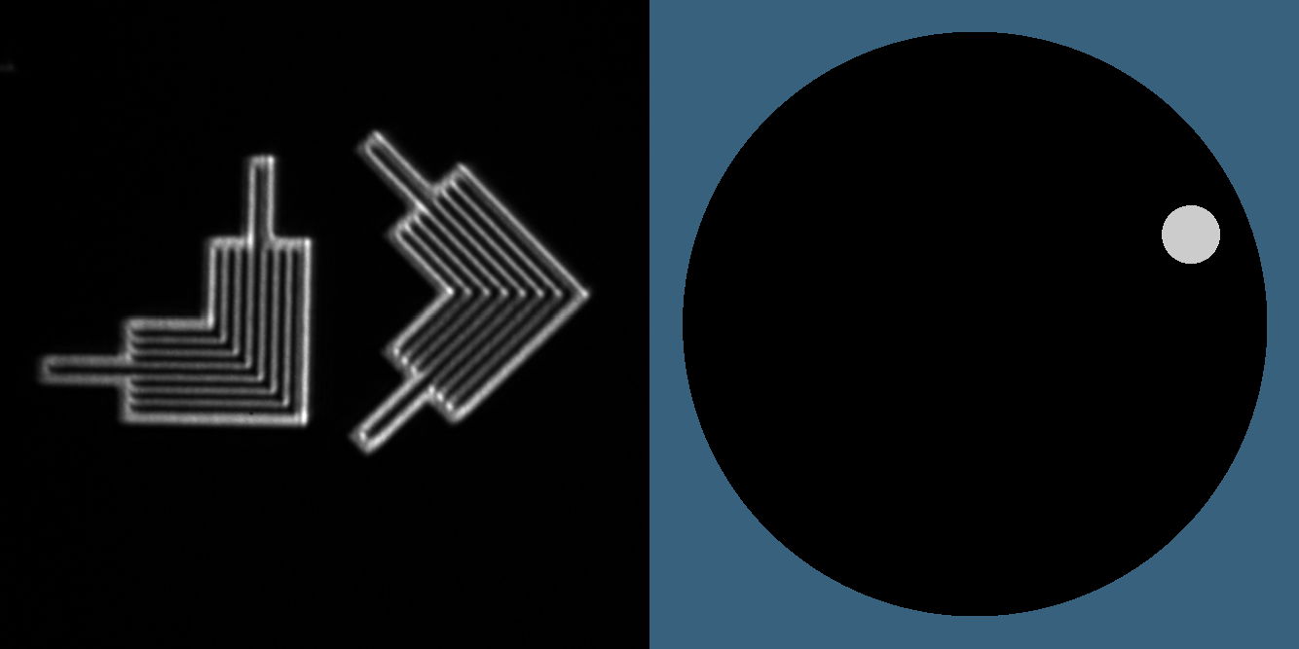
Pupil-fill affects imaging
Elbows, 100-nm CD
0.33 4xNA pupil
Notes:
Rotate around, and we see the different line directions lose or gain contrast.

Slide 46
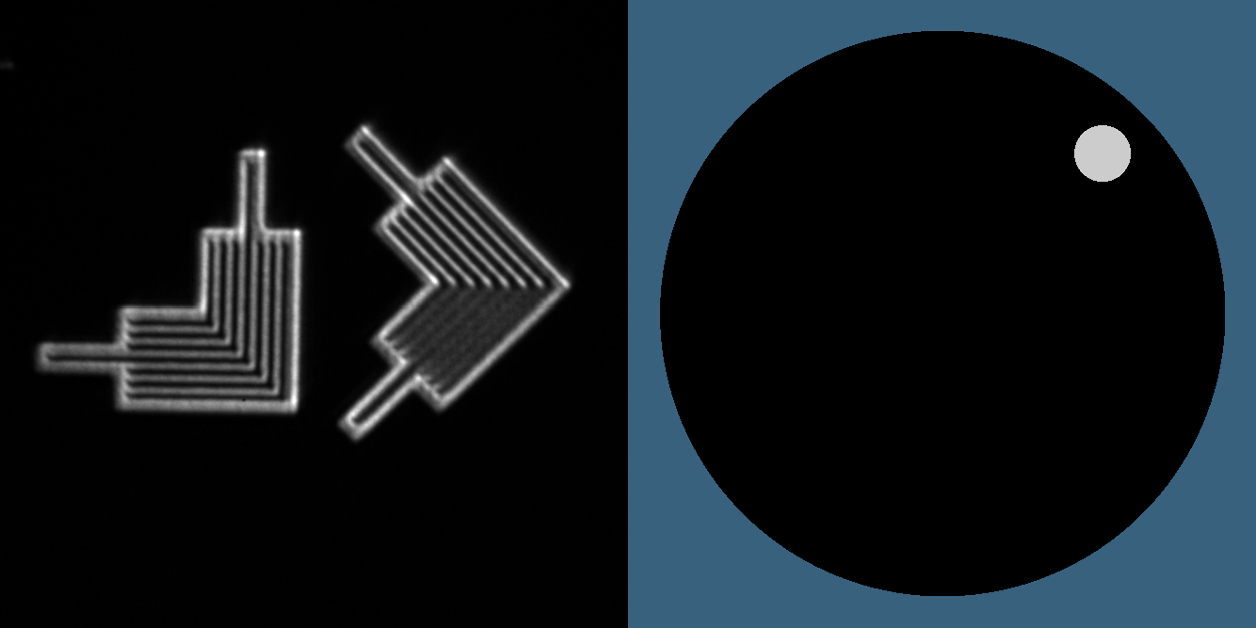
Pupil-fill affects imaging
Elbows, 100-nm CD
0.33 4xNA pupil

Slide 47
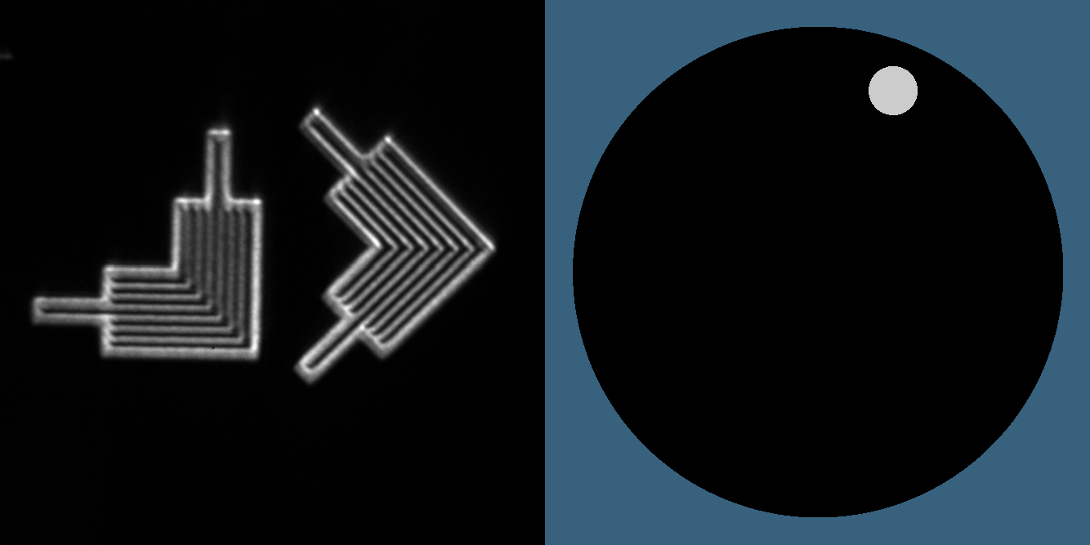
Pupil-fill affects imaging
Elbows, 100-nm CD
0.33 4xNA pupil

Slide 48
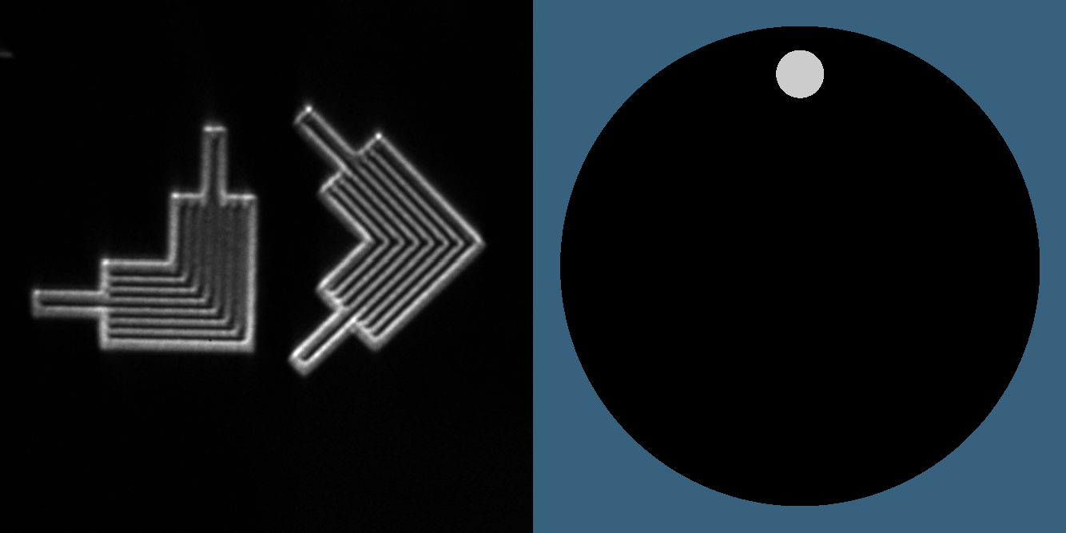
Pupil-fill affects imaging
Elbows, 100-nm CD
0.33 4xNA pupil

Slide 49
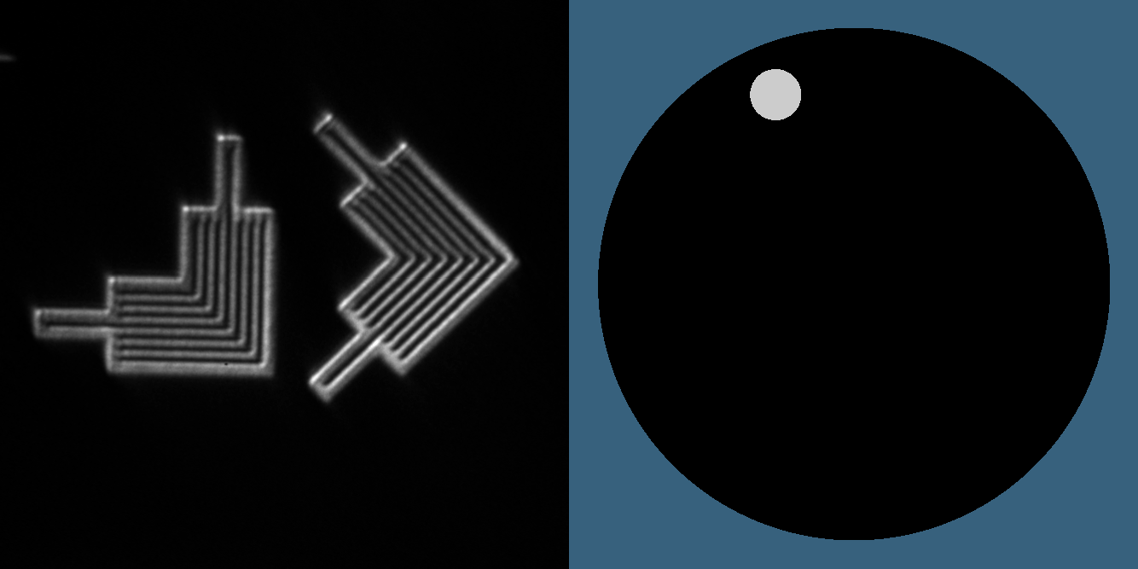
Pupil-fill affects imaging
Elbows, 100-nm CD
0.33 4xNA pupil

Slide 50
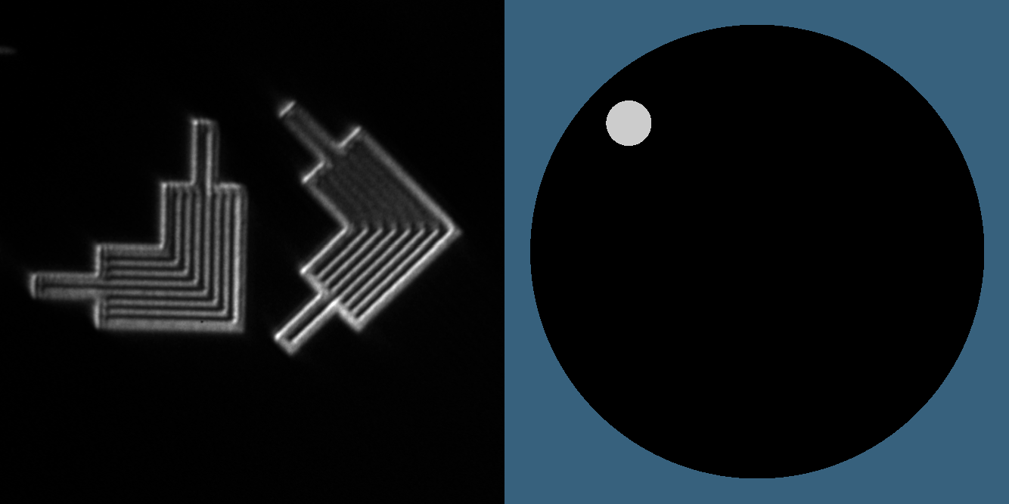
Pupil-fill affects imaging
Elbows, 100-nm CD
0.33 4xNA pupil

Slide 51
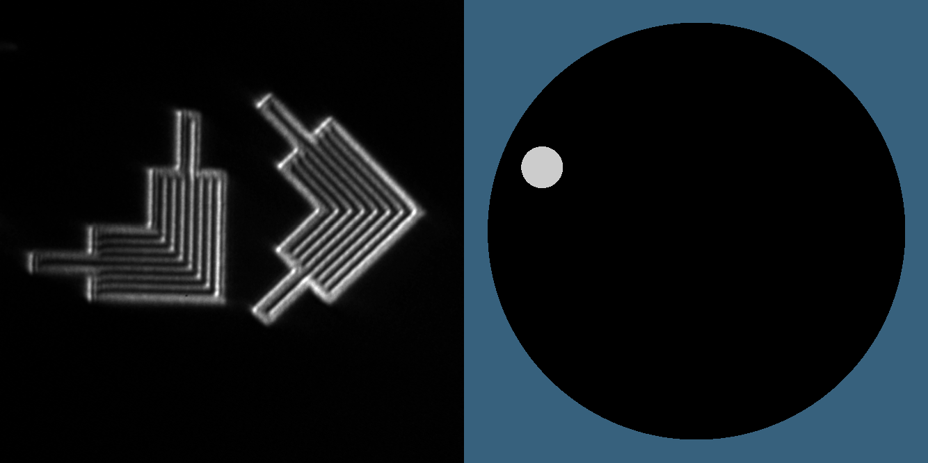
Pupil-fill affects imaging
Elbows, 100-nm CD
0.33 4xNA pupil

Slide 52
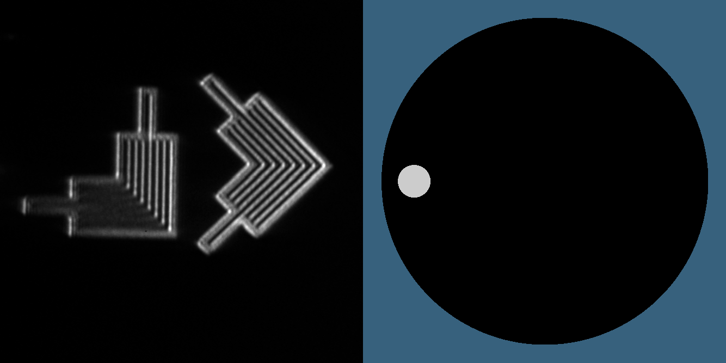
Pupil-fill affects imaging
Elbows, 100-nm CD
0.33 4xNA pupil
Notes:
And as we go around, we’re beginning to understand how to synthesize…

Slide 53
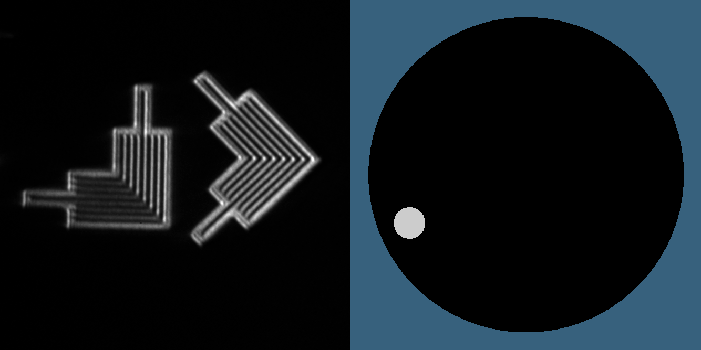
Pupil-fill affects imaging
Elbows, 100-nm CD
0.33 4xNA pupil

Slide 54
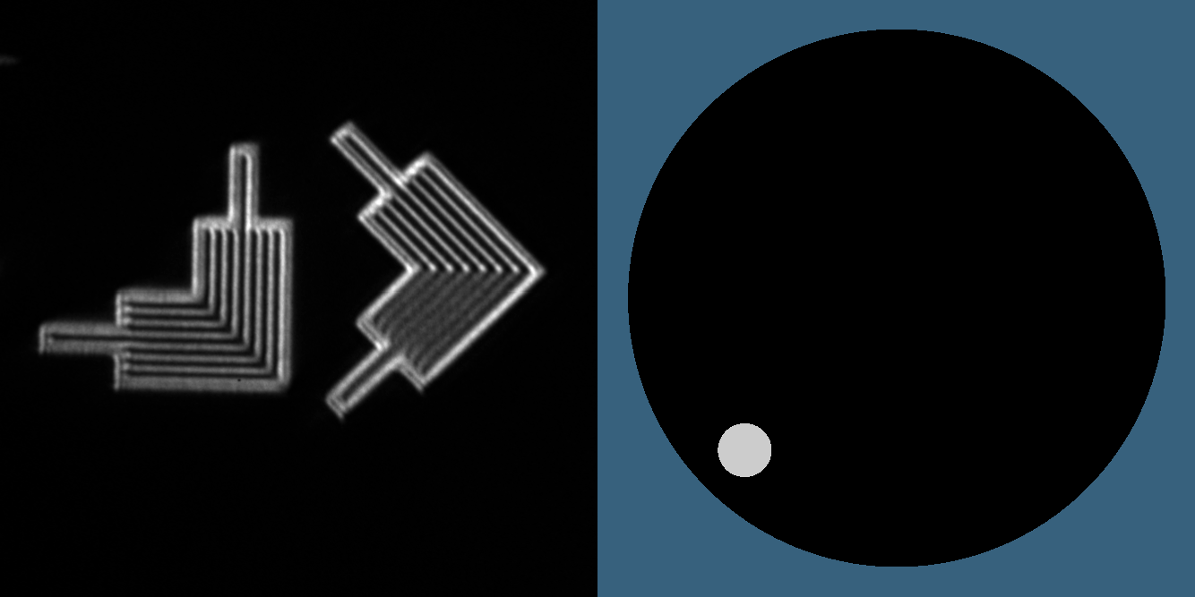
Pupil-fill affects imaging
Elbows, 100-nm CD
0.33 4xNA pupil

Slide 55
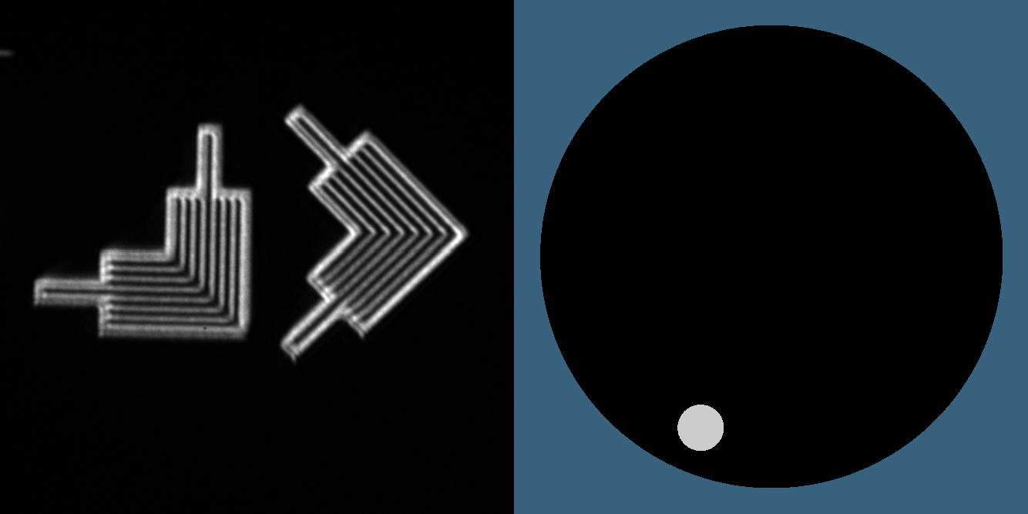
Pupil-fill affects imaging
Elbows, 100-nm CD
0.33 4xNA pupil

Slide 56
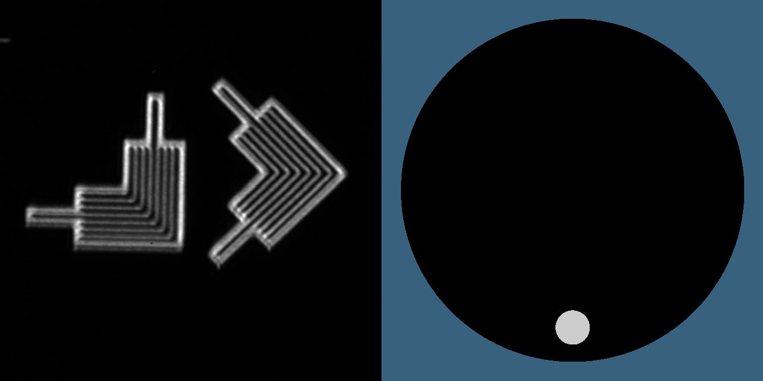
Pupil-fill affects imaging
Elbows, 100-nm CD
0.33 4xNA pupil

Slide 57
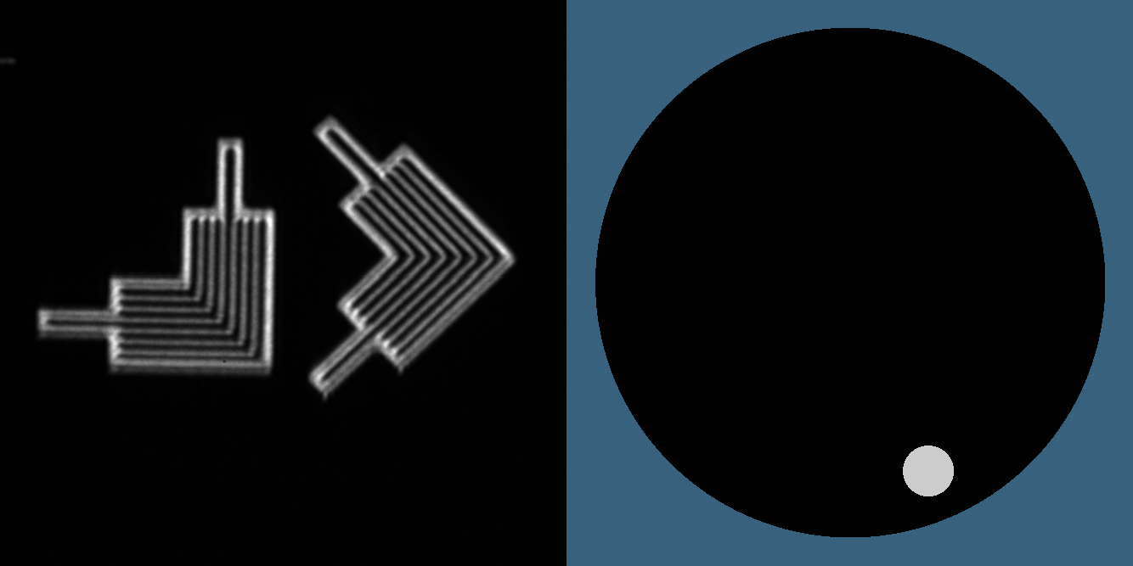
Pupil-fill affects imaging
Elbows, 100-nm CD
0.33 4xNA pupil

Slide 58

Pupil-fill affects imaging
Elbows, 100-nm CD
0.33 4xNA pupil

Slide 59

Pupil-fill affects imaging
Elbows, 100-nm CD
0.33 4xNA pupil

Slide 60

Pupil-fill affects imaging
Elbows, 100-nm CD
0.33 4xNA pupil

Slide 61

Pupil-fill affects imaging
Elbows, 100-nm CD
0.33 4xNA pupil
Notes:
annular illumination. We trace that out during each exposure.

Slide 62


Coherence affects edges
0.5 µm
σ = 0.1
σ = 0.5
coherent
partial coherence
Notes:
For lithography, this demonstration shows how dialing UP the partial coherence strongly reduces ringing and smooths out the lines. It also demosntrates what we can observe using SHARP

Slide 63

Coherence affects roughness
0.5 µm
σ = 0.05
σ = 0.5
coherent
partial coherence
Notes:
A similar experiment with a single dark line, allows us to see how partial coherence kills the ringing, and reduces the speckle contrast sunstantially.

Slide 64

σ
Contrast vs. z & σ
Mochi, et al., SPIE 888022 (2013)
1.0
0.8
0.6
0.4
0.2
~0
focus
-2.4
-1.2
0
1.2
2.4
µm
110-nm CD, 0.25 4xNA pupil
Notes:
This experiment conducted by Iacopo Mochi, created a matrix of images that should be in an optics textboox. Here we have 11 different through-focus series recorded at varying partial coherence from coherent at the bottom to incoherent at the top.

Slide 65

Coherence control helps to find best focus
1
contrast
0
focus
focus
focus
1.5 µm
σ = 0.1
σ = 0.5
σ = 0.9
100-nm lines, Δz = 0.5 μm / step
Notes:
That work led us to realize that we could use the coherence control to find focus unambiguously. Consider this 100-nm-CD line pattern. WIth coherent light, the contrast rings and it’s nearly impossible to tell where you are in focus. Yet when we increase sigma, we kill the ringing, and there’s just one peak. Markus Benk first suggested using this to determine focus with dense line patterns, and now it’s our standard method.

Slide 66
High NA
for high spatial resolution

Slide 67

4xNA
110-nm CD
4xNA
Pupil
0.25
0.50 σ
0.25
0.33
0.38 σ
0.33
0.35
0.35
0.36 σ
0.42
0.42
0.30 σ
0.50
0.25 σ
0.50
Notes:
Imagine an experiment where you keep the illuminating beam and the mask constant, and you increase the spatial resolution of the lens.
Here we have 110-nm cd lines. This cartoon shows where the diffraction orders go within the pupil and this is real EUV data from SHARP
showing how those lines appear

Slide 68





4xNA
110-nm CD
I(x)
0.25
0.50 σ
0.33
0.38 σ
0.35
0.36 σ
0.42
0.30 σ
0.50
0.25 σ
x

Slide 69
Some user data

Slide 70








Native defect, illumination studies
Goldberg, et al., SPIE 88800T9 (2013)
Mask/KLA617
Teron
Quasar 45°
illumination
Annular
illumination
Mask/KLA617 Teron
GREMLIN3-130709-0031
SHARP
GREMLIN3-130709-0032
Mask/SEM
1.5 µm
200 nm hp

Slide 71

Native defect, illumination studies
Goldberg, et al., SPIE 88800T9 (2013)
Mask/KLA617
Teron
Pre-Repair
Post-Repair
Mask/SEM
110 nm hp

Slide 72






Native defect, illumination studies
Goldberg, et al., SPIE 88800T9 (2013)
Mask/KLA617
Teron
Disk 0.9 σ
illumination
Annular
illumination
Quasar 45°
illumination
GREMLIN3-130709-0012
GREMLIN3-130709-0029
GREMLIN3-130709-0030
Mask/SEM
SHARP
1.5 µm
110 nm hp

Slide 73





Native phase and amplitude defects
phase
amplitude
focus
2.0 µm
Goldberg, et al.,
SPIE 88800T9 (2013)

Slide 74


Substrate roughness experiments
2-µm
132-nm hp
(intentional roughness)
focus
Goldberg, et al.,
SPIE 88800T9 (2013)

Slide 75
Performance,
Future directions, and
Areas for improvement
Notes:
Q: How is SHARP doing?

Slide 76
Stability
Illumination Uniformity
Data Collection Rate
New Lenses
Notes:
In the remaining time, I’m going to look at a few key issues for SHARP’s performance. In addition to lens quality, if there’s any one factor that I think affect’s the quality of the data,
we collect, I would say it’s the Illumination Uniformity. When you’re collecting a series of data for through-focus analysis, that’s the imaging property that can most easily cause problems in the analysis.

Slide 77



Mechanical (spatial) stability
series 1
series 2
series 3
5 images
1 µm
100-nm CD lines, 5 s exposure
Notes:
And how are we doing on mechanical stability? We invested considerable attention into making a super stable platform for nanoscale imaging.

Slide 78
Mechanical (spatial) stability
series 1
series 2
series 3
5 images
1 µm
velocity
5s blur
0.026 nm/s
0.13 nm/exp
0.039 nm/s
0.19 nm/exp
0.072 nm/s
0.36 nm/exp
mask units
Notes:
The system is performing extremely well, actually. Using a Fourier domain technique, I can track the subtle x motion of these lines on a sub-pixel basis.
I can see that the motion is below 72 pm/s. Which means that in a typical 5 s image…(data above).

Slide 79

Uniformity scanner: static beam
3 µm
Notes:
We create uniformity by scanning our focused beam across the region of interest. This is an image of our beam in an entirely bright region of a mask.

Slide 80

Uniformity scanner: XY Raster (simulated)
3 µm
Notes:
Choosing a serpentine path like this allows us to paint with light, during each exposure. The pattern we choose, along with the stability of the system dictate how uniform the beam can be.

Slide 81

Uniformity scanner: XY Raster (measured)
11
images
3 µm
Notes:
Here’s an example of 11 images through focus, where our goal is to uniformly illumiate a square region with either 3, 4, or 5 micron width.

Slide 82


Stability of power and uniformity
power ∫I dA
uniformity max |ΔI|
RMS
average
3 µm
4 µm
5 µm
3 µm
4 µm
5 µm
Notes:
How did we do? Well there are 2 metrics. First is average power in the box. Here we see that the normalized RMS variation can be about 1% for the smaller region. And now uniformity, which we define here as the maximum relative departure from the average value. For the smaller, 3 micron region, we’re seeing intensity fall within 1.6% of the average value, and within about 2 percent for the 5 micron region.

Slide 83
Number of high-resolution images recorded
AIT: 97,600
January 2007
to September, 2012
5 years
SHARP: 71,000
June 2013
to February 2014
8.5 months
5x output rate
> 3x SNR
Notes:
Now, let’s talk about speed. Operational for just 8.5 months, SHARP is already a highly productive tool. For comparison, with AIT, the system is replaced…(data).
And we’re about to double these numbers by adding a second shift of operations per day, starting in Q2. Over 70% as many images in 1/7th the time.

Slide 84
Data Collection Time
navigtion & fine alignment
+ series collection
Notes:
SHARP is run manually, by people, but the measurement locations can be pre-loaded, and the series are recorded in an automatic way. What’s left is navigation and fine alignemnt, including focusing.

Slide 85


Data collection rate
January 15, 2014: Afternoon
5-second exposure
17 images / series
Notes:
Here’s a smooth afternoon of work. In about 3 hours we collect 28 series using 5 second exposure time and 17 images per series. Between each series, we navigate to the next measuremetn position and then perform fine alignment. The overall rate is about 8.9 series/hour.

Slide 86

Stepping through focus
100-nm CD, σ = 0.5
–3.6
–2.0
0
2.0
3.6
µm
17 Steps
400-nm / step
(25-nm wafer equivalent)
MET10-130719-0049
Notes:
We almost always collect through-focus data. 17 steps with 400-nm mask-side steps is typical. But is that really necessary? The DOF depends sensitively on sigma and the pattern pitch.

Slide 87

Q: How many steps are necessary?
Bossung curve
100-nm CD, σ = 0.5
5%
dose
levels
MET10-130719-0049
Notes:
Here’s a Bossung plot from the previous data, and you can see how smooth the pattern is. We might be able to cut down the measurement time by tuning the step size dynamically. But for now, the conservative approach is to oversample the data for the users.

Slide 88




Point-to-point navigation & alignment times
blank
w/ marks
patterned
mask
Notes:
I took a look at two different masks we measured this year, one blank with marked defects, and another patterned with measurement locations along a kind of grid. These plots show the time lag between the end of one series and the start of the next. It’s mostly smooth sailing, but we ocasionally have to spend extra time navigating, or possibly the operator steps away to get more coffee, or take a phone call from the users. In both cases, we find that it takes the operator about 2 minutes to move, realign and start the next series. In other words, about one quarter of the total operation time is spent navigating. In any scenario, we’re not going to expect a big improvement in this aspect of the tool.

Slide 89
New Lenses
Reduced aberrations at high NA
Lenses for
    enhanced defect sensitivity
    phase detection
increased DOF
Notes:
The final improvement I’ll mention is New Lenses. We have very high efficiency zoneplates, but we believe that stress in the free-standing patterns has caused the high-NA lenses to become astigmatic. We’re making new lenses where stress won’t be an issue. We’re also looking into clever lens designs, some old ideas and some new, that will allow us to enhance defect detection, measure phase point by point to improve feedback for repairs, and to increase the single-image sweet spot diameter.

Slide 90




SHARP was created by LBNL’s Center for X-Ray Optics
Come Work With Us
Notes:
Finally, here’s the team that put together the tool last year. There are some new faces who have joined us in 2014, and we would love to work with you. We’re open to collaborations and working with groups inside and outside of SEMATECH. So let us help you investigate cutting edge issues in EUV masks.

Slide 91
ACKNOWLEDGMENTS
SEMATECH: | Kevin Cummings, Stefan Wurm, C.C. Lin, Andy Ma, Frank Goodwin, Harry Kwon, Bryan Rice, (David Chan)
IBM:
Emily Gallagher
Intel:
Pei-Yang Yan
(GlobalFoundries:)
Tom Wallow
SEE ALSO
• Goldberg, et al., SPIE 867919 (2013)
• Goldberg, et al., SPIE 88800T9 (2013)
• Mochi, et al., SPIE 888022 (2013)
info: sharp.lbl.gov
This work was funded by SEMATECH under Agreement No. LB08005006, and is performed
under the auspices of the U.S. Department of Energy by the University of California Lawrence Berkeley
National Laboratory under management and operating contract DE-AC02- 05CH11231.

