Slide 1
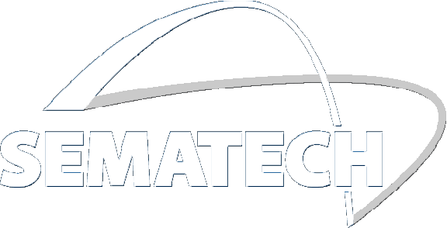
New Source and Imaging Capabilities of the SHARP EUV Mask Microscope
Kenneth A. Goldberg
Lawrence Berkeley National Laboratory
Markus Benk, Antoine Wojdyla, Alex Donoghue, David Johnson, James Macdougall, Weilun Chao, Ryan Miyakawa, Yow-Gwo Wang, and Patrick Naulleau
KAGoldberg@lbl.gov EUVL Symposium 2014 October 2014
Notes:
This talk is about lenses, math, source, and masks. It’s about the great things you can do with the SEMATECH-funded SHARP EUV actinic mask microscope.

Slide 2
Note: MANY of the slides in the presentation have
animations that are only visible in slideshow mode.
There are also speakers notes for many of the slides
to explain the intent.
KAGoldberg@lbl.gov EUVL Symposium 2014 October 2014
Notes:
This talk is about lenses, math, and source, masks

Slide 3
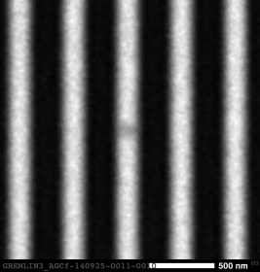
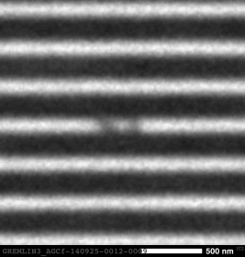
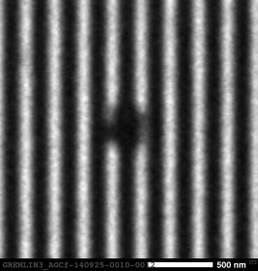
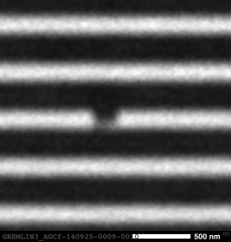
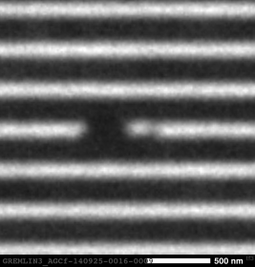
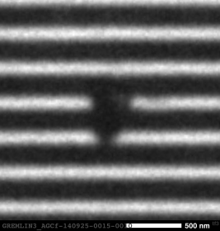
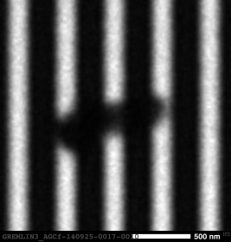
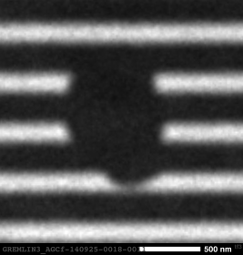
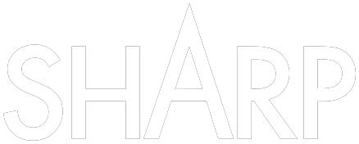
Courtesy Mangat, Wood: GlobalFoundries
GREMLIN3_AGCf-140925-0009 through 0018 excluding 0012 and 0013
Notes:
We spend a lot of time recording IMAGES of defects. Small, large, programmed and native.

Slide 4
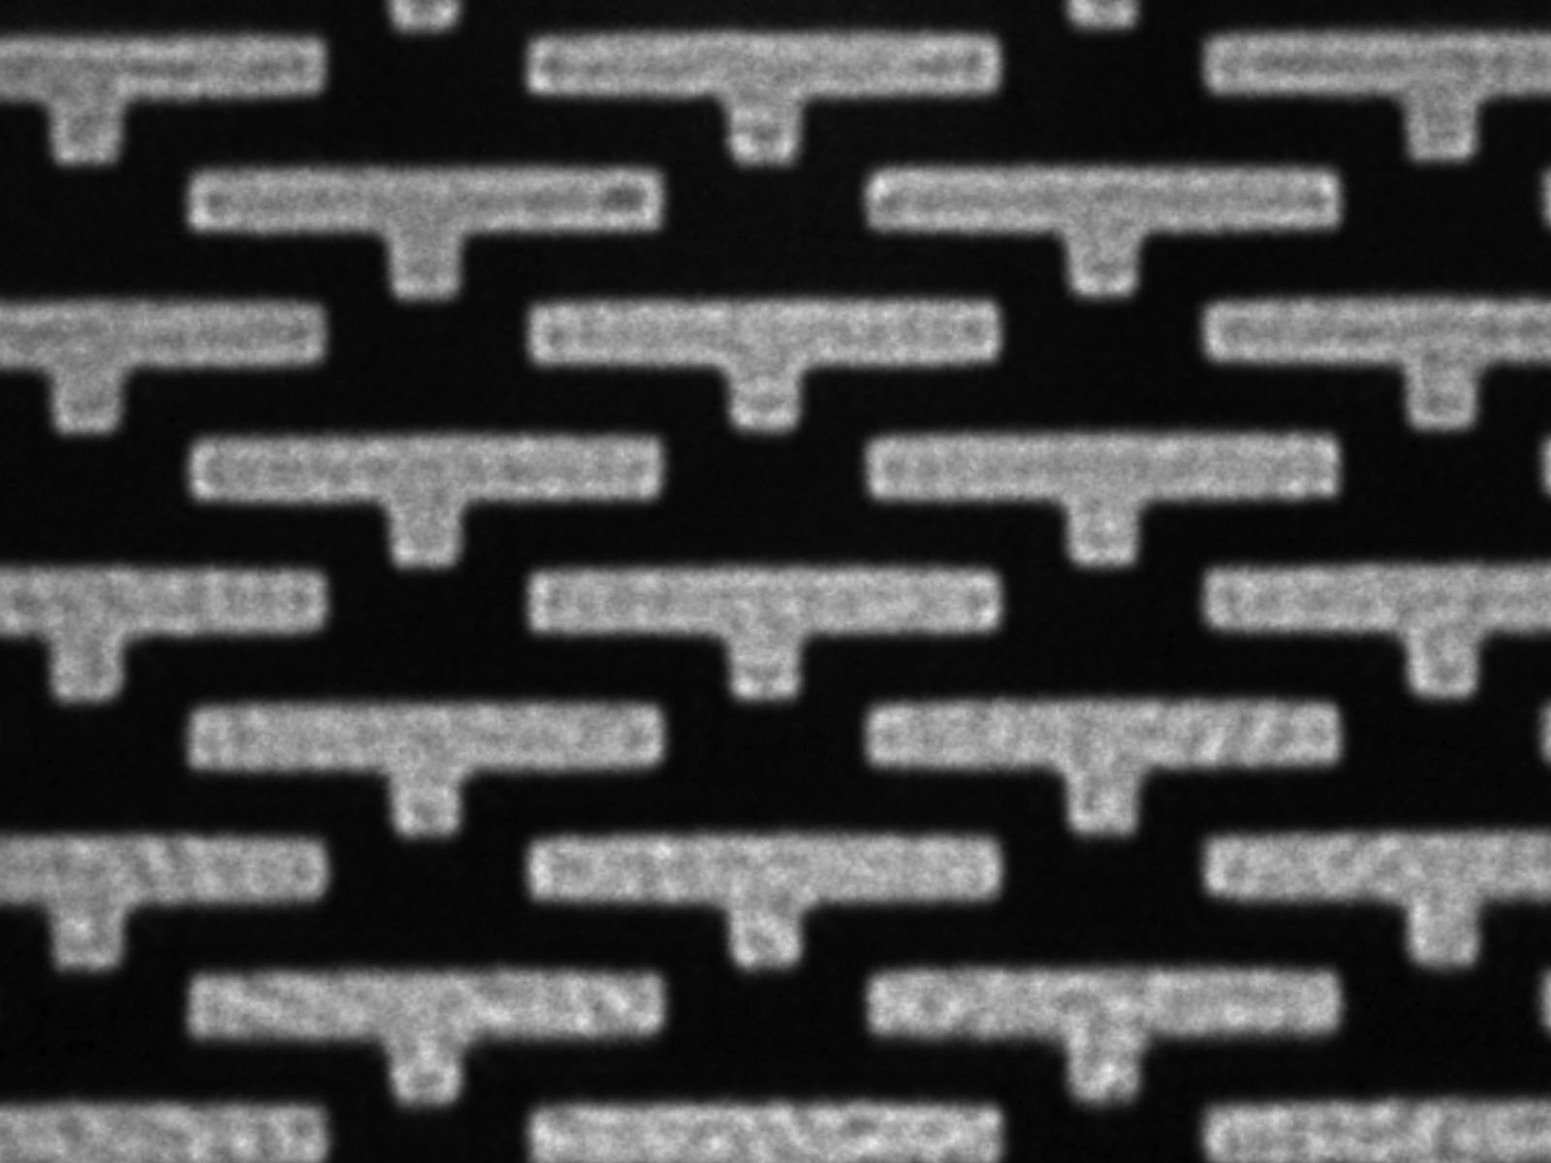
Notes:
But what if I told you that that every time you record an IMAGE, half the information is lost. It’s there, it’s just not recorded

Slide 5
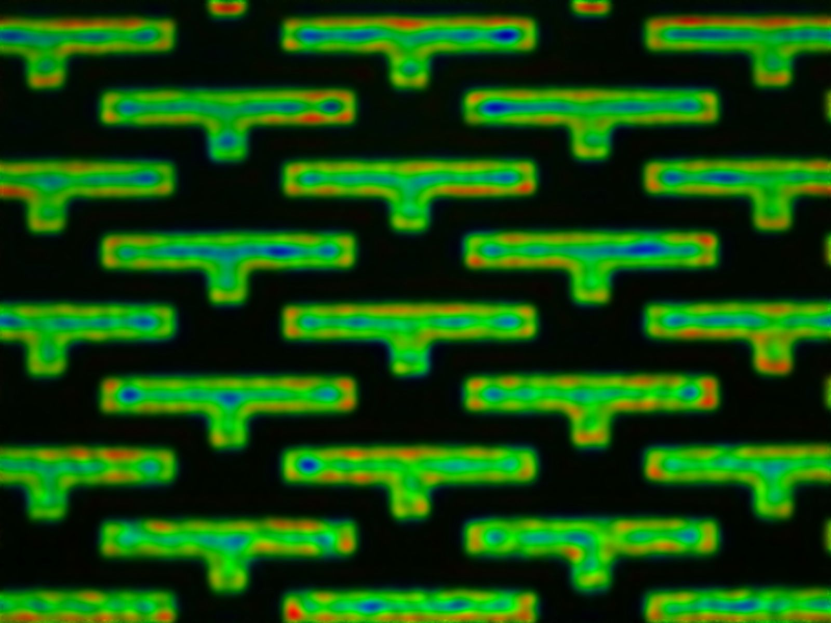
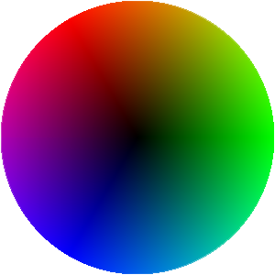
Notes:
Of course, I’m talking about PHASE. But why should we care about phase?

Slide 6
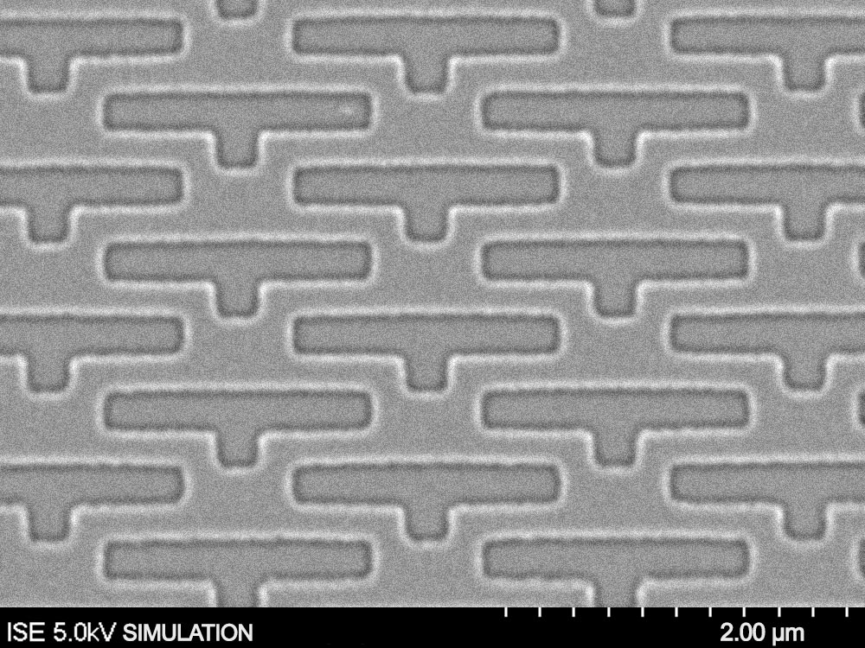
Notes:
Photoresist doesn’t care about phase, only intensity.
We care about Phase because phase dictates everything about how the light moves. The phase defines the local direction of propagation.
It determines whether an almost invisible defect ruins the process window, and whether surface roughness becomes line roughness that’s too much to tolerate.

Slide 7
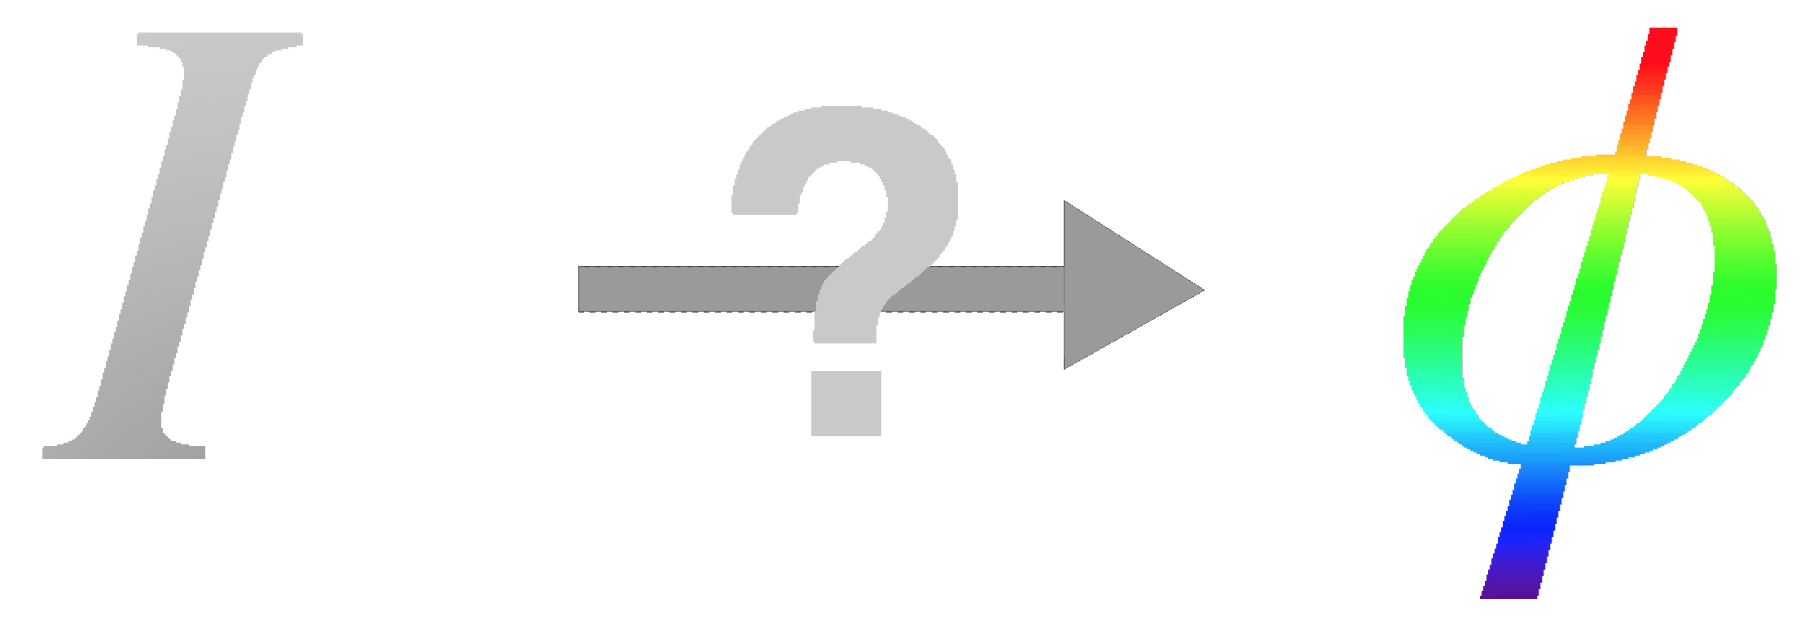
ANIMATION
Notes:
How can we turn intensity into phase, or somehow extract the complex amplitude from our data?

Slide 8
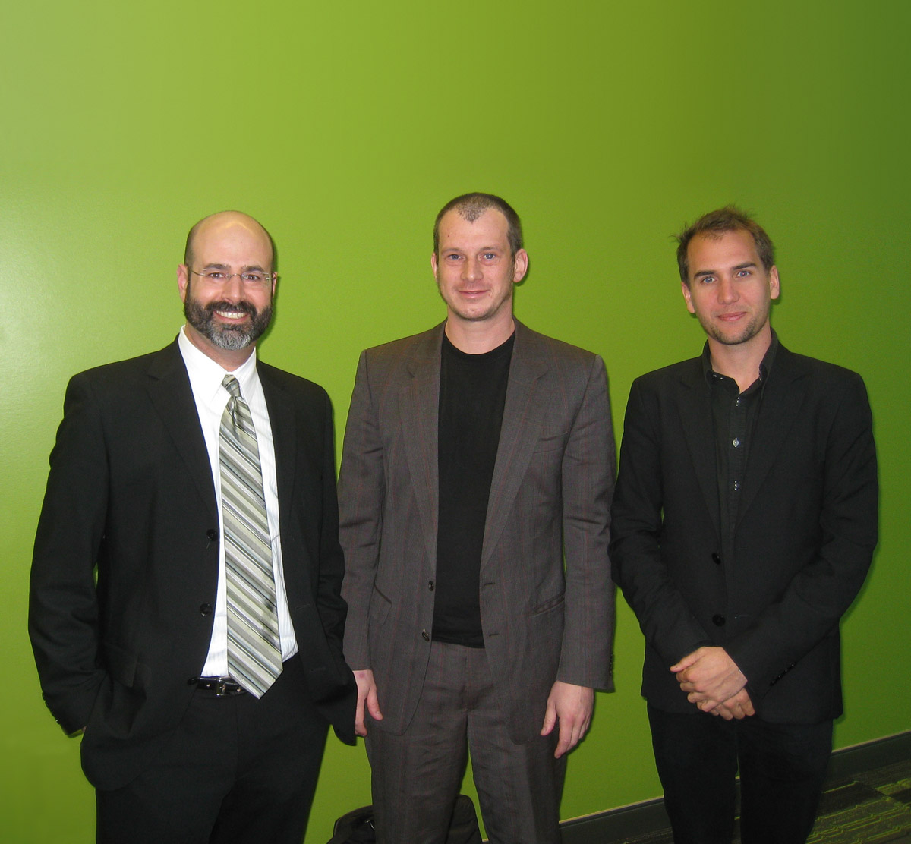
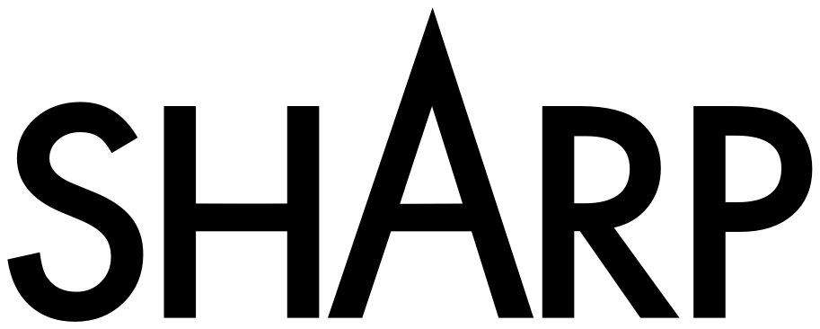
I(σ)
φ(x)
ANIMATION
Goldberg
Benk
Wojdyla
Notes:
These are my colleagues Markus Benk, and Antoine Wojdyla, and we spend a lot of time talking about imaging, sources, and phase.
We realized that with holographic lenses installed in SHARP, we have the opportunity to bring 100 years worth of interesting techniques from visible-light microscopy to EUV microscopy, many for the first time.

Slide 9
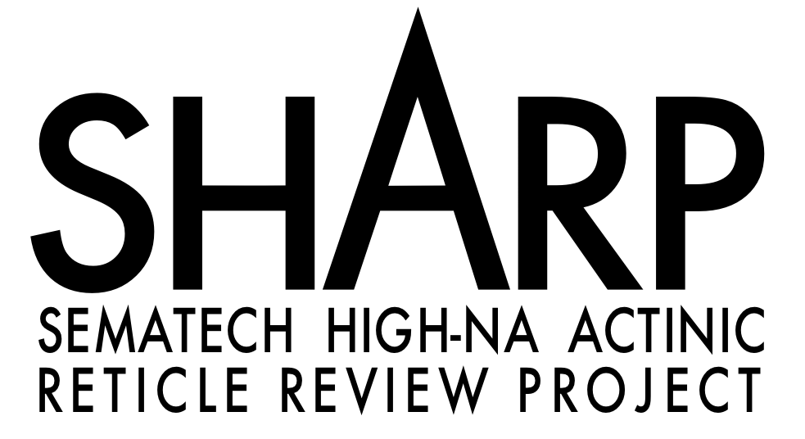
Source: Synchrotron
Optics: Mirrors & Zoneplate-lenses
4×NA: 0.25–0.625
σ: Programmable
Nav: Full-mask xy
Speed: ~8 series/hr
Notes:
So this is SHARP. SHARP is a synchrotron-based research prototype designed to emulate current and future litho tools hopefully for MANY years and MANY generations to come.

Slide 10
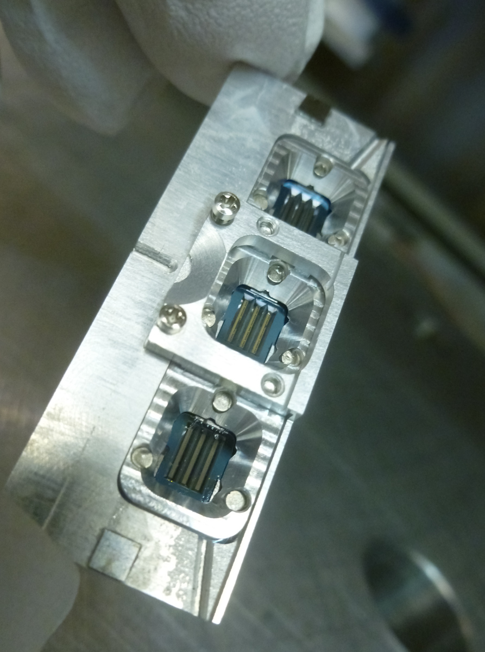
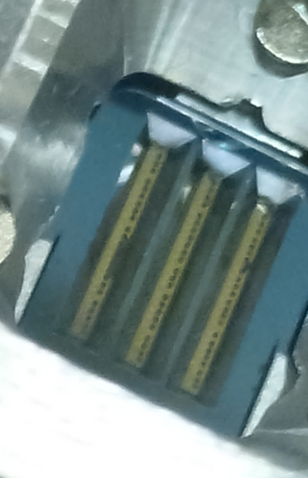
SHARP Zoneplate Arrays
4 mm
Notes:
The zoneplate holder has space for 3 chips and about 200 zoneplates. So we thought, let’s do something interesting and useful, something different with these lenses.

Slide 11
ANIMATION
Notes:
Even OPRAH was talking about new lenses. I saw this and we thought: “Oh, No! Oprah has published first!” But no, it turns out she was talking about something else.

Slide 12
logic pattern
0.5 μm
IMO113715-140909-0031
Notes:
Let me show you what I mean. Here’s a logic pattern

Slide 13
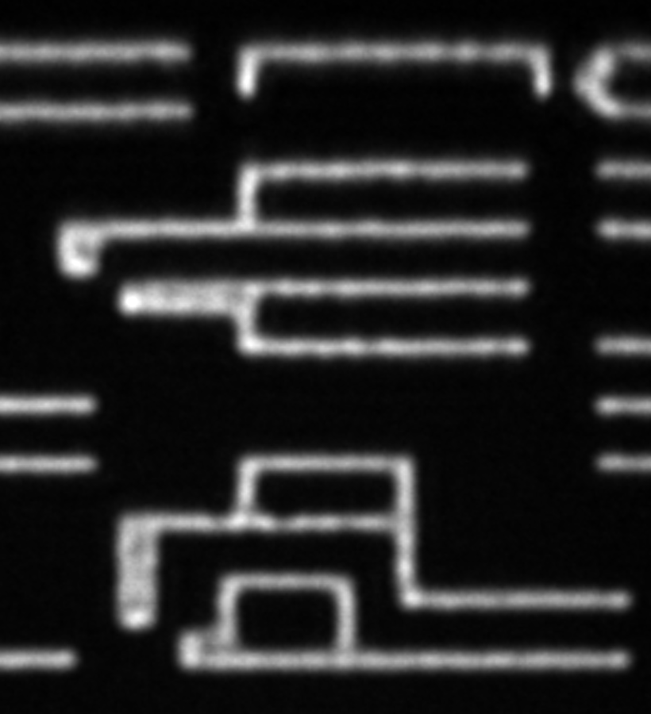
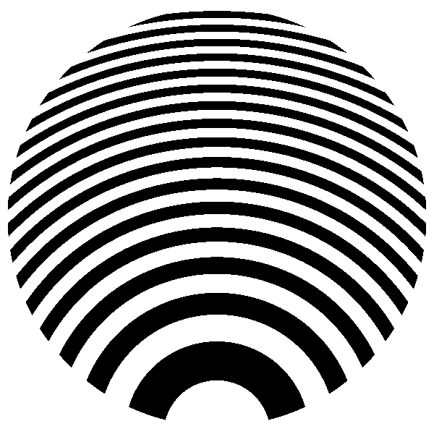
ANIMATION
conventional
lens
0.5 μm
IMO113715-140909-0031
Notes:
and here’s a conventional image recored on sharp. These are pretty skinny lines, and it’s an old, rough mask.

Slide 14
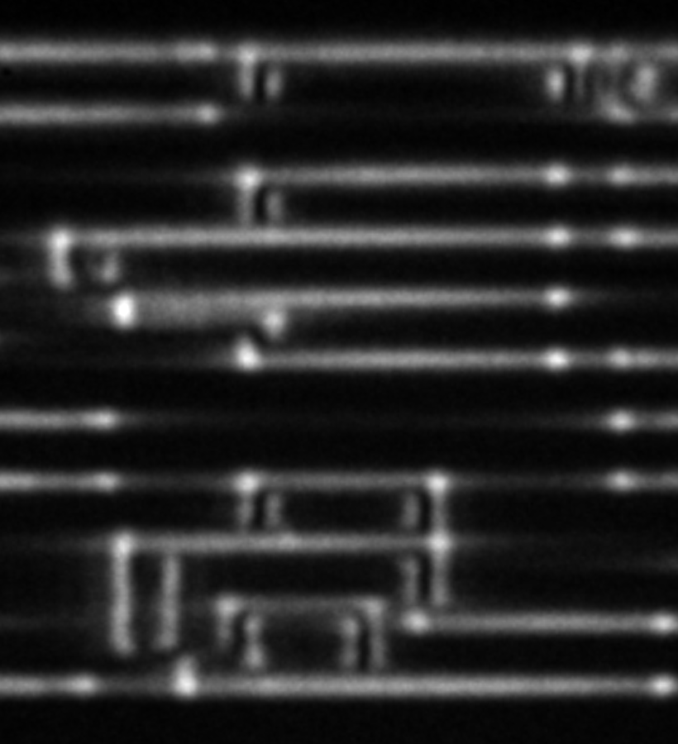
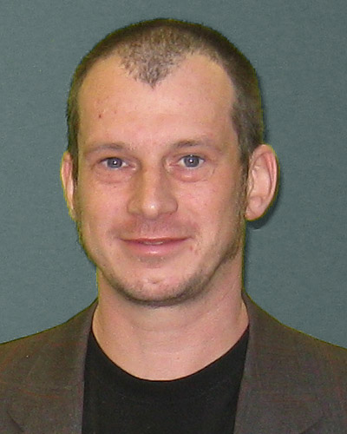
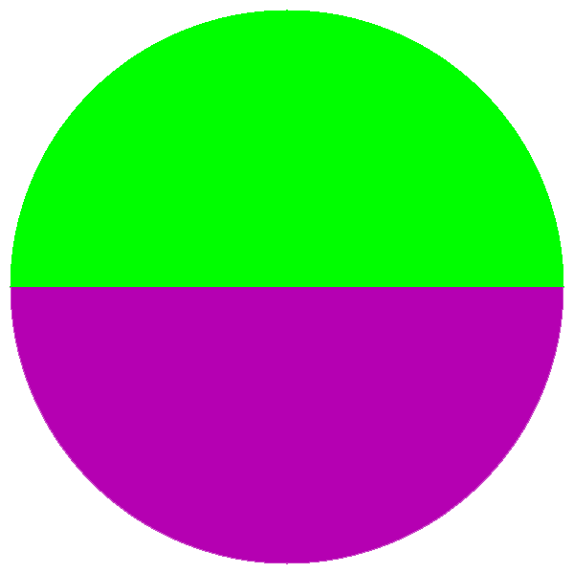
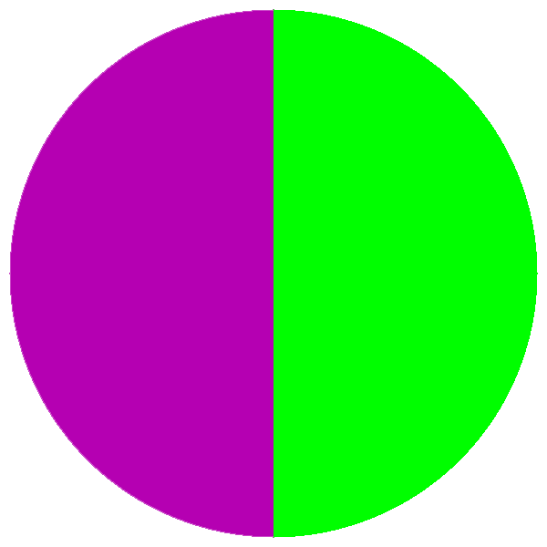
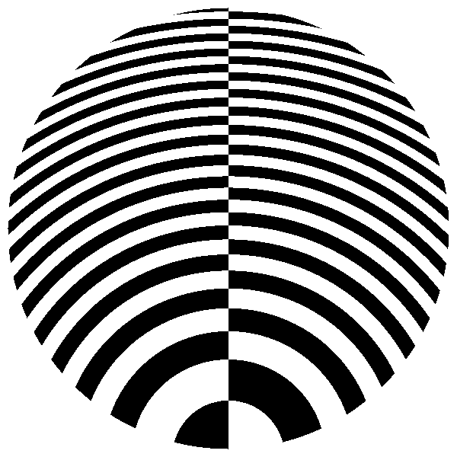
π
Markus Benk
ANIMATION
Differential
X lens
∂A/∂x
0.5 μm
IMO113715-140909-0031
Notes:
We can apply clever microscopy concepts directly to our holographic lenses. These in particular are ones that Markus has been working on.
These lenses, with a pi phase shift between the two sides perform a derivative right in the lens.

Slide 15
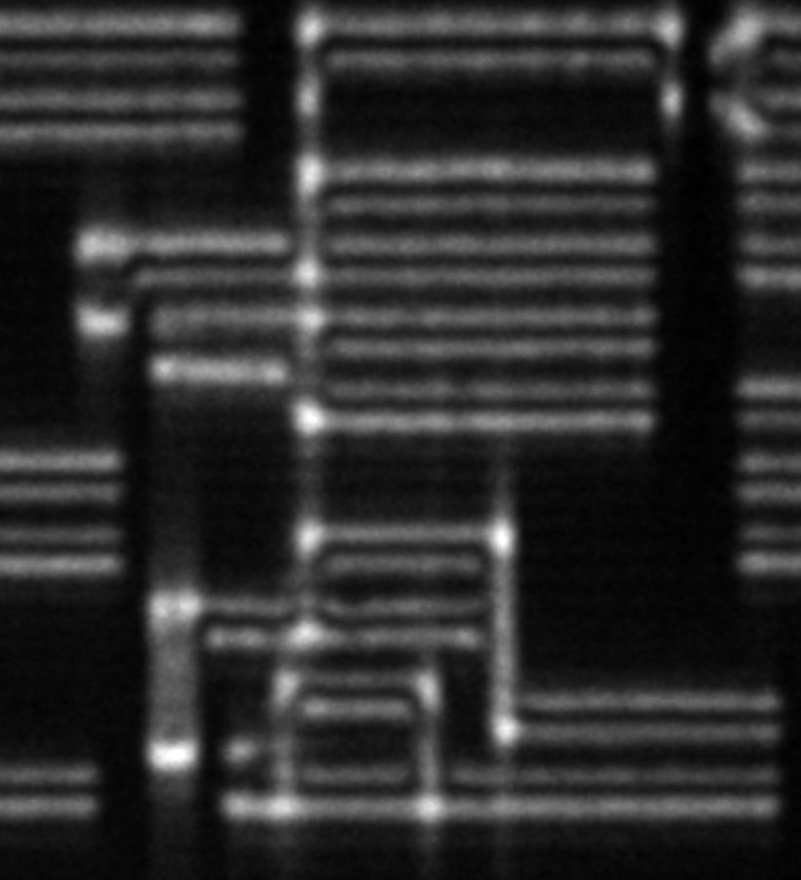
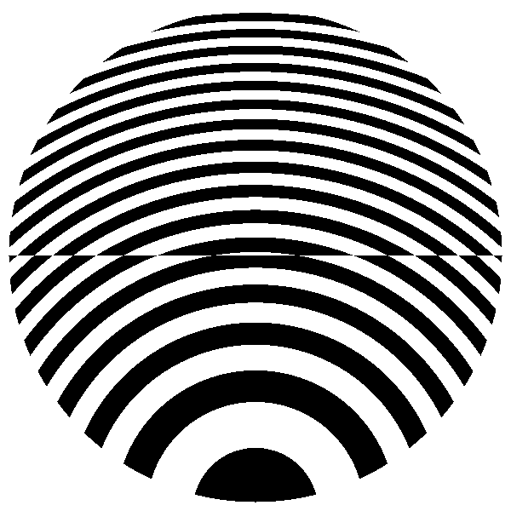
π
ANIMATION
Differential
Y lens
∂A/∂y
0.5 μm
IMO113715-140909-0031

Slide 16
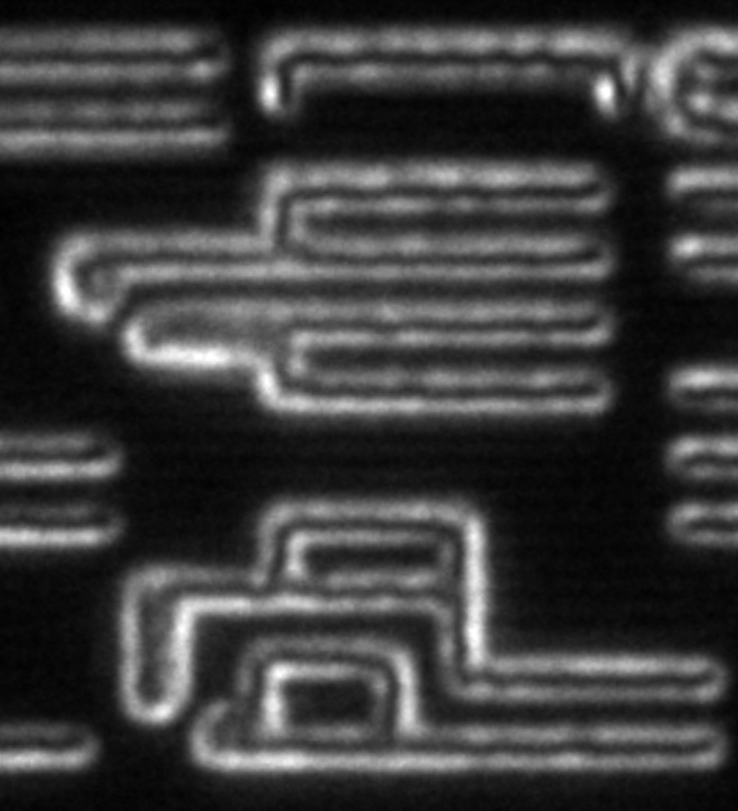
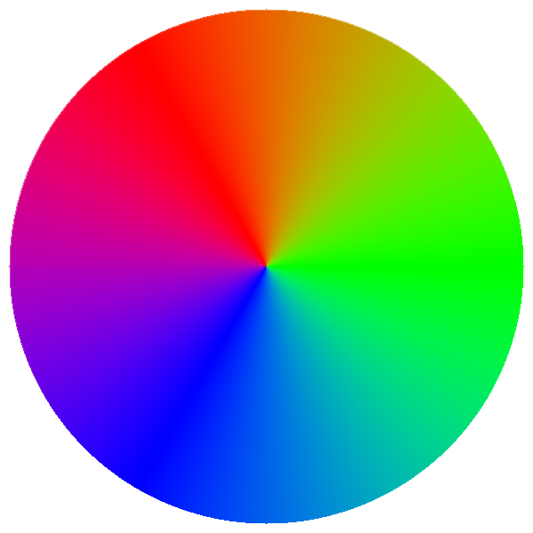
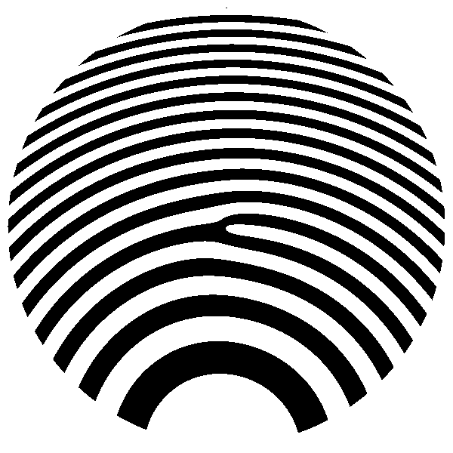
ϕ
ANIMATION
Spiral
phase
0.5 μm
IMO113715-140909-0031
Notes:
The spiral phase zoneplate makes every diffracted order cancel its complementary point, leading to a zero on-axis and a halo around the edges.

Slide 17
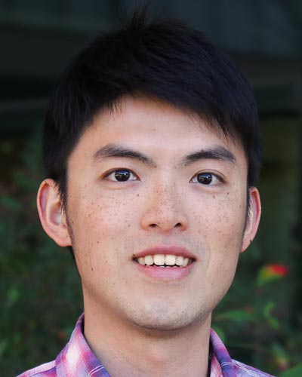
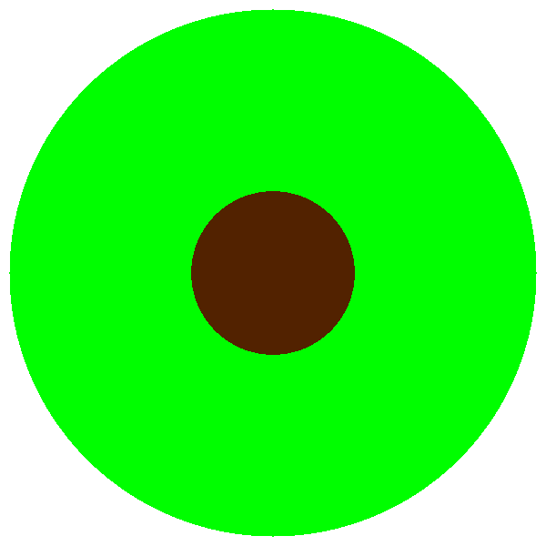
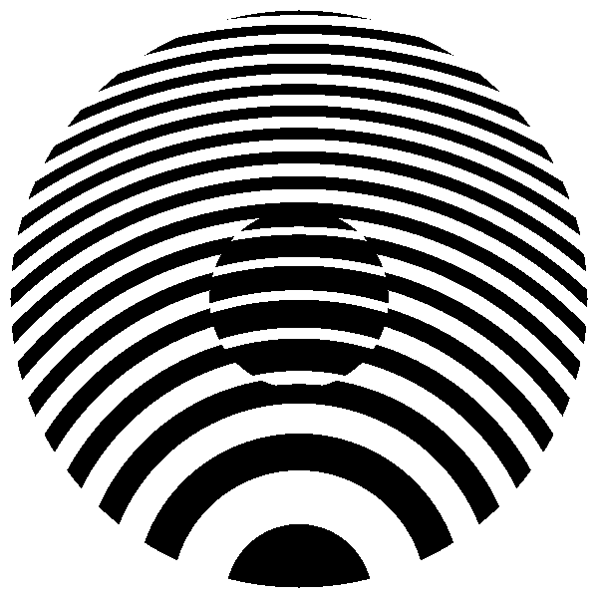
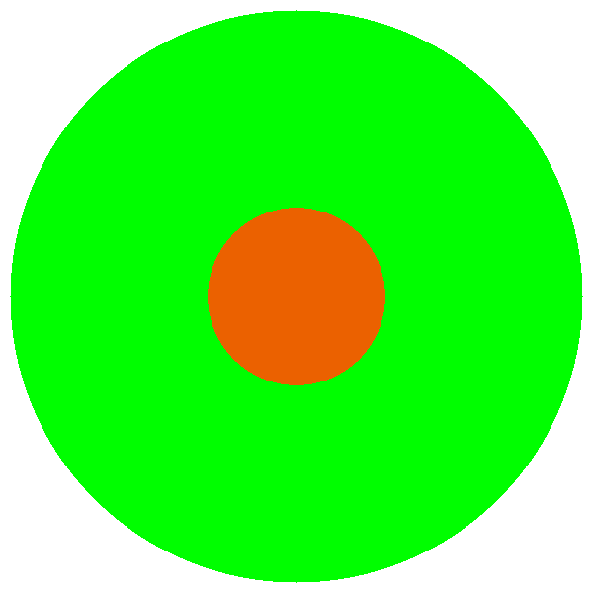
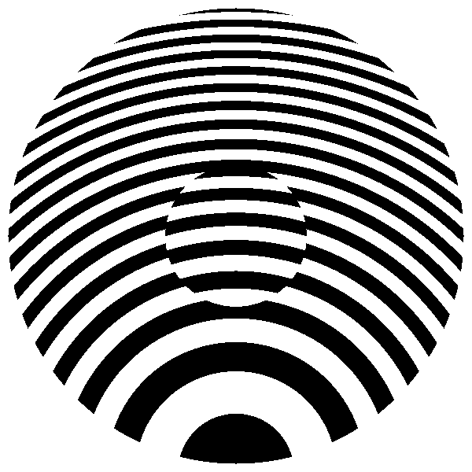
Zernike phase contrast (ZPC)
Markus Benk
Yow-Gwo Wang
ANIMATION
π/2
π/2
See: SPIE Advanced Lithography 2015
See: Talk today, 10:15 am
Notes:
Another famous example is Zernike phase contrast. I’m going to leave that to future papers, and a talk later this morning by Henry Wang.

Slide 18
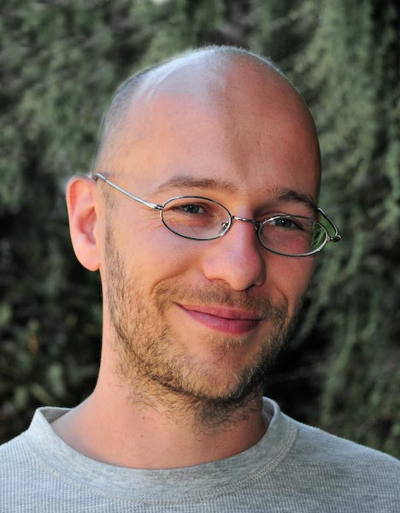
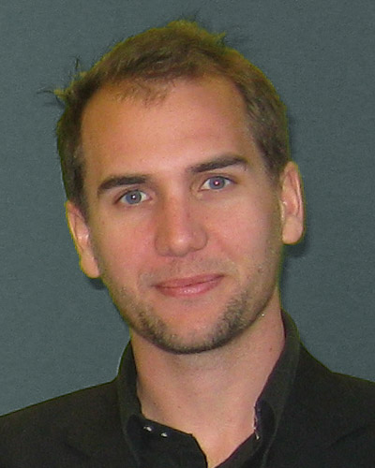
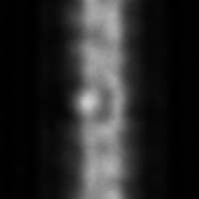
Through-Focus Phase Reconstruction*
Modified Gerchberg-Saxton Method
*Mochi, et al. SPIE 79691X (2011).
Mochi
Wojdyla
ANIMATION
200 nm
through-focus, Δz = 400 nm
complex amplitude, 35° phase bump
Notes:
Another way to extract phase is from through-focus data, as Iacopo Mochi did when he was working with us on the AIT and SHARP, using a modified Gerchberg-Saxton algorithm.

Slide 19
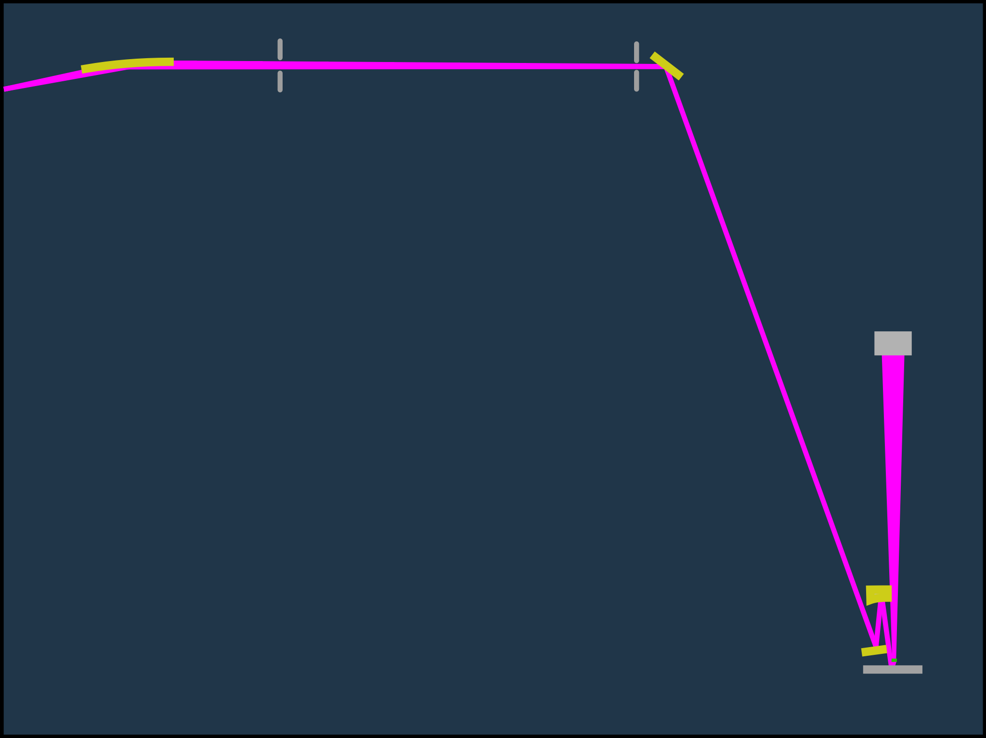
KBy
KBy
M_{A}
M_{A}
beamline
focus
CCD
CCD
0.45 m
0.45 m
M_{C}
M_{C}
M_{B}
Not to scale
M_{B}
Not to scale
Mask
Mask
Notes:
SHARP has a very flexible illuminator that allows us to emulate nearly any pupil fill pattern.
The beamline comes to an intermediate focus at the first mirror of the 3-mirror illiuminator. That spot is re-imaged with 10x demagnification down onto the mask. A tiny zoneplate lens catches the reflected light and sends a high-magnification EUV image up to the CCD camera.

Slide 20
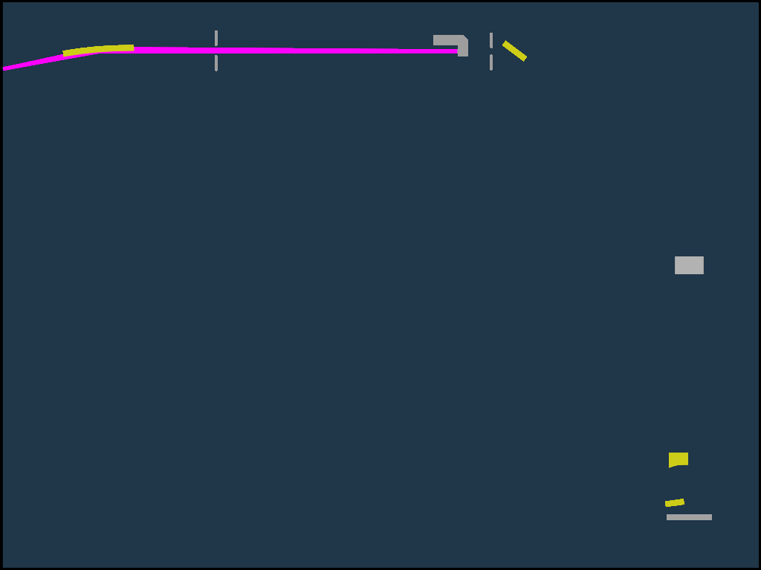
KBy
M_{A}
coherence
control
beamline
focus
CCD
ANIMATION
0.45 m
M_{C}
Not to scale
M_{B}
Mask
Notes:
There are two active elements. The MA mirror scans the illumination angle and generates arbitrary, fully programmable partial coherence. MB is a flat, turning mirror. And MC is an off-axis ellipsoid that re-images the beam onto the mask. MC shakes ever so slightly, provding a way to paint out the beam uniformity on the scale of microns to tens of microns.

Slide 21
Poster
Wojdyla
Antoine
Wojdyla
Notes:
One of the tricks we can employ is a relatively new technique called Fourier Ptychography Microscopy. Antoine has a very nice poster on what you can do with it.

Slide 22
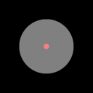
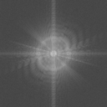
Fourier Pytchography Microscopy*
Mathematically synthesize high-NA from many coherent views
*G. Zheng, et al. Nature Photonics 7, 9 (2013).
Wojdyla
ANIMATION
Illumination angles
Fourier-domain reconstruction
0.5 μm
Notes:
It works like this. In series, you record images by coherently illiuminating the mask from a grid of different angles. Then you reconstruct,
or SYNTHESIZE a larger spatial frequency response in the Fourier Domain. Notice the white ring is the size of the original pupil

Slide 23
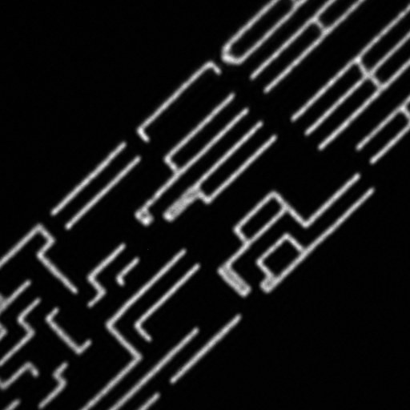
coherent
1 μm
SHARP_2014-05-03/IMO113715,21,3
Notes:
Here is a coherent image of a logic pattern at 45°

Slide 24
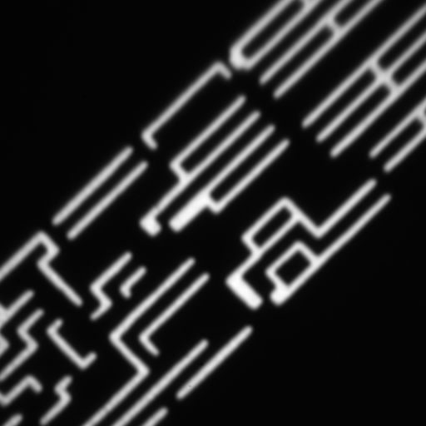
incoherent
1 μm
Notes:
And an incoherent image.

Slide 25
Fourier ptychography
intensity
1 μm
Notes:
Now with FPM, we can resolve much finer details. Notice the break in the line, and the super-high resolution.

Slide 26
Fourier ptychography
complex
amplitude
1 μm
Notes:
You can even extract the complex amplitude

Slide 27
x
Differential Phase-Contrast Microscopy*
(I_{R}–I_{L}) / I_{net}
∂φ/∂x
ANIMATION
*Mehta, Optics Letters 34 (13), 2009 • Tian, Optics Letters 39 (5), 2014
• Xibin Zhou, Dominic Ashworth, Kevin Cummings, EUVL Symposium 2014
Notes:
Another technique, which I saw mentioned in a SEMATECH poster last night is DPC.
The idea is that you combine images recorded with complementary, symmetric illumination patterns, and that reveals the phase.

Slide 28
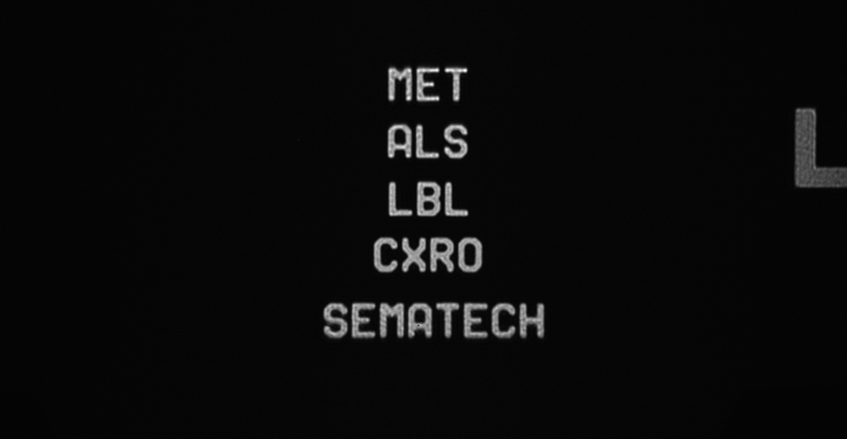
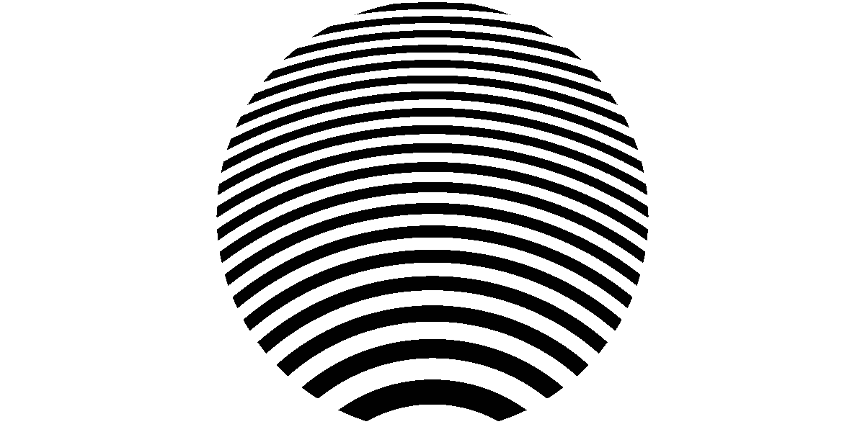
Conventional Lens
SHARP image
2 µm
Notes:
OK, phase is great, but what about 3D information? Here’s a coherent image of some logos.

Slide 29
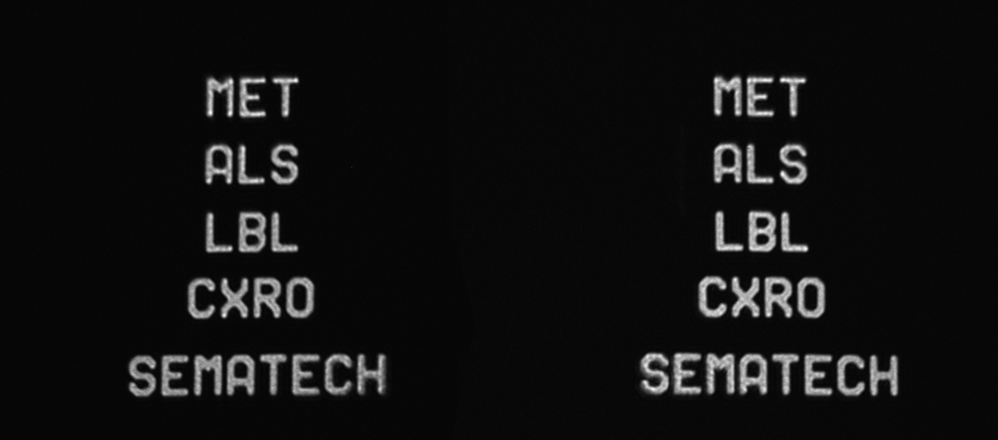
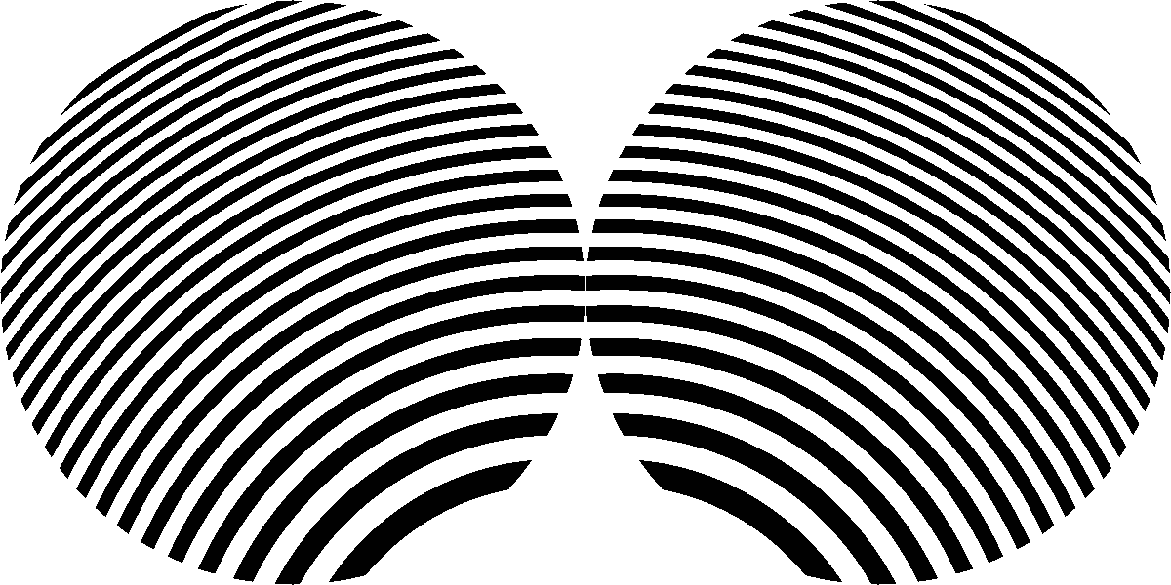
Stereo Lens
ANIMATION
2 µm
SHARP image
Notes:
I realized that if we split the lens, make a binocular lens we could image two different views of the mask two perspectives at the same time.
Here we’re illuminating the mask from two different dipoles, and the lenses project images to side by side parts of the CCD. This is a single image.

Slide 30
Stereo Lens
- Left
- Center
- Right
Working
toward 3D imaging
ANIMATION
2 µm
animated
Series: 140923-0003
Notes:
Cycling back and forth you can see the perspective that comes from the different angles of illumination.

Slide 31
- Left
- Right
ANIMATION
1 µm
140923-0004
Notes:
Here’s another example.

Slide 32
- Left
- Right
ANIMATION
0.5 µm
Notes:
What I’m interested in, and I haven’t quite figured out, is what’s going on with the speckle here, and the corners.
They’re clearly different from the two angles.

Slide 33
Coherence affects roughness (speckle)
ANIMATION
1 µm
SHARP_CAL_DISK-140904-0005-0003
Notes:
We all know that the illumination coherence has a strong effect on the imaging properties. So in SHARP, we always tune the illumination partial coherence to match the user’s requests for each pattern.

Slide 34
Users’ illumination pupil-fill requests
Notes:
Here are the illumination pupil fill patterns that the users have requested. You can see disk, dipole, quasar, cross-pole, and various annular patterns.

Slide 35
SHARP condenser
visible light
position Illumination angle
Notes:
We achieve those patterns losslessly as follows. Here’s a visible-light image of the illuminator pupil. Think of this as a map of the illumination angles.

Slide 36
Coherence Control: Pupil Fill Patterns
EUV
Notes:
Using the MEMS mirror we scan out angluar patters in time, filling the pupil several times in each exposure.

Slide 37
Coherence Control: Pupil Fill Patterns
0.5 4xNA 0.8 σ 8° CRA
Notes:
Here’s a sampling of fill patterns and how we achieve them. All of these images were recorded with a YAG microscope that looks up into the illuminator.

Slide 38
Coherence Control: Pupil Fill Patterns
0.5 4xNA 0.2–0.8 σ 8° CRA

Slide 39
Coherence Control: Pupil Fill Patterns
0.5 4xNA 1.0 σ 8° CRA

Slide 40
Coherence Control: Pupil Fill Patterns
0.5 4xNA 1.2 σ 8° CRA

Slide 41
Coherence Control: Pupil Fill Patterns
0.625 4xNA 1.0 σ 10° CRA

Slide 42
Coherence Control: Pupil Fill Patterns
0.25 4xNA 1.0 σ 6° CRA

Slide 43
Coherence Control: Pupil Fill Patterns
0.25 4xNA 0.2 σ 6° CRA

Slide 44
Coherence Control: Pupil Fill Patterns
0.25 4xNA 0.05 σ 6° CRA

Slide 45
Coherence Control: Pupil Fill Patterns
0. 5 4xNA 0.4–0.8 σ 8° CRA

Slide 46
Coherence Control: Pupil Fill Patterns
0.5 4xNA 0.4–0.8 σ 8° CRA

Slide 47
Coherence Control: Pupil Fill Patterns
0.5 4xNA 0.4–0.8 σ 8° CRA
Notes:
OK, that’s all the conventional stuff. But what about something new, something relevant.

Slide 48
“From performance validation to volume introduction of ASML’s NXE platform”
H. Meiling, et al., SPIE 8322, 83221G (2012).
NXE:3300B
illuminator
faceted
pupil mirror
“EUV Lithography Industrialization Progress” Rudy Peeters, [ASML] (2014-10-27)
Notes:
Recently we’ve seen ASML and Zeiss discussing their facted mirror illuminator. These images are from Hans Meiling’s SPIE paper in 2012.
and Yesterday Rudy Peters discussed this for EUV as well. SHARP is ready to emulate these capabilities.

Slide 49
Coherence Control: Pupil Fill Patterns
0.5-NA 0.4–0.8-σ 8° CRA
45° CROSSPOLE (22.5° arc)
animated
Notes:
We ran these demonstrations with our SCANNING ILLUMINATOR to show what we can do.

Slide 50
Coherence Control: Pupil Fill Patterns
0.5-NA 0.4–0.8-σ 8° CRA
45° CROSSPOLE (22.5° arc)
animated
Notes:
we have full control of the pattern.

Slide 51
“Freeform illumination sources: An experimental study of source-mask optimization for 22 nm SRAM cells.” J. Bekaert, et al., SPIE 7640, 764008 (2010). [ASML, Zeiss]
Notes:
So we can consider some of this innovative Source Mask Optimization work coming from ASML and Zeiss.

Slide 52
Freeform source patterns
Notes:
And here, we demonstrate this with a pixellated pattern.

Slide 53
Freeform source patterns

Slide 54
Freeform source patterns
Notes:
So if our users request customized freeform patterns for Source-Mask Optimization, we can give it to them

Slide 55
Poster
Markus
Benk
Notes:
I’ll refer you to the excellent poster presentation by Markus Benk showing that we have a lot of control

Slide 56
Freeform source patterns: grayscale
animated
Rendered on 0.5 4xNA, 8° CRA
Notes:
Thinking broadly about free-form illumination, it occurred to me that there could be some benefit from allowing each source pixel to have VARIABLE intensity.
So we set about to demonstrate it with our scanning illuminator in SHARP. Here’s a few different patterns.

Slide 57
Freeform source patterns: grayscale
animated
Rendered on 0.5 4xNA, 8° CRA
Notes:
Here’s an example with variable intensity per pixel and increasing pixel density.

Slide 58
Freeform source patterns: grayscale
Notes:
With our illuminator, you can do nearly anything. We can even render this familiar face.

Slide 59
Freeform source patterns: grayscale
animated
Rendered on 0.5 4xNA, 8° CRA
Notes:
With our illuminator, you can do nearly anything. We can even render this familiar face.

Slide 60
Off-axis angles complicate EUV lens & ML design
10°
8°
6°
4°
2°
0°
Angle of incidence
Notes:
OK, let’s change gears. There’s been a lot of discussion with the problems of large angles of incidence and ML mirrors. There’s phase effects, apodization,
and it really causes some problems for the future, making high-NA EUV very difficult. Increasing the mask-side NA, requires going farther off-axis.

Slide 61
Anamorphic EUV optics and SHARP
mask
Notes:
That brings us to a discussion of Anamorphic imaging, which SHARP can do as well.
Start with a conventional lens and a dense pattern you want to print. Now say we want to shrink this by 8x.

Slide 62
Anamorphic EUV optics and SHARP
8x
4x
Mag
mask
Notes:
Start by shrinking the mask horizontally. Now we’ll use the lens to shrink the image by 8x and 4x to render the pattern with a normal isomatric NA on the wafer side.
Now we’re going to make the system anamorphic, so the mag is higher vertically than horizontally. You’ll see why in a second.
What’s important is that on the wafer side, the NA is the same in x and y. So we’ll need a higher Mag in the y direction.

Slide 63
Emulating anamorphic lenses in SHARP
8x
4x
Mag
ANIMATION
mask
image
Notes:
need a dense pattern

Slide 64
Emulating anamorphic lenses in SHARP
8x
4x
Mag
ANIMATION
10°
8°
6°
4°
2°
0°
Angle of incidence
mask
image
Notes:
need a dense pattern. Notice that we don’t exceed an already high angle of incidence.

Slide 65
Emulating anamorphic lenses in SHARP
8x
4x
Mag
mask
image stretch
Notes:
need a dense pattern

Slide 66
Materials & Architecture
Mag
NA
Repair
Defects
Phase
shifting
ANIMATION
Pattern
roughness
Source-mask
optimization
Substrate roughness
Notes:
Let’s talk about the big questions in EUV Masks. You may have 99 problems, but I think these are the top 9. What binds all of these together is that as you go to smaller nodes, you need actinic inspection as part of the development. SHARP is making contributions to all of these areas.

Slide 67
Measuring Phase Differential Lenses Zernike Phase Contrast Through-Focus Phase Reconstruction Fourier Ptychography Microscopy Differential Phase Contrast
Stereo lenses, a path to 3D
Source customization for SMO Binary and Grayscale Sources
Anamorphic lens emulation (future)
Notes:
Lots of ways to measure phase. Stereo lenses. Source customization. Anamorphic lenses, in the future.

Slide 68
Come work with us!
Notes:
We’re now running 2 shifts per day, and we’ve hired some enthusiastic young research associates to run extra shift.
Oh wait, that’s too young.

Slide 69
Notes:
We’re now running 2 shifts per day, and we’ve hired twoenthusiastic young research associates to run extra shift.

Slide 70
Notes:
Oh wait, that’s too young.

Slide 71
SHARP Team 2014
Kenneth Goldberg
Principal Investigator
Markus Benk
Project Scientist
Antoine Wojdyla
Postdoctoral Fellow
David Johnson
Research Associate
Alex Donoghue
Research Associate
James Macdougall
Graduate Student
Notes:
Here’s our team, and here are our new team members (orange), David and Alex.

Slide 72
special thanks
SEMATECH:
Anne Rudack Frank Goodwin
Stefan Wurm Kevin Cummings
GlobalFoundries:
Pawitter Mangat, Obert Wood
RIT:
Zachary Levinson, Bruce Smith
Intel:
John Magana
sharp.lbl.gov
This work was funded by SEMATECH under Agreement No. LB08005006, and is performed under the auspices of the U.S. Department of Energy by the University of California Lawrence Berkeley National Laboratory under management and operating contract DE-AC02- 05CH11231.

