Slide 1
Fourier Synthesis Illuminator for EUV mask inspection tool
Markus P. Benk, Kenneth A. Goldberg, Iacopo Mochi, Patrick P. Naulleau
SRI2013, Gaithersburg MD, June 20

Slide 2
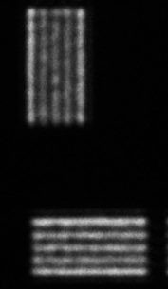
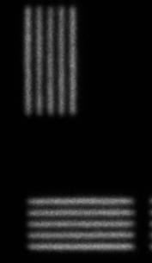

Slide 3
Outline
Introduction
SHARP microscope
Fourier Synthesis Illuminator
Concept
Layout
Components
Pupil-fill
Uniformity
Images
Effect of illumination on imaging
Summary

Slide 4
Mask inspection
SHARP
Sematech High-NA Actinic Reticle Review Project
Defect on
EUV photolithography mask
SEM image
Mochi, SPIE 7636 (2009)

Slide 5
Mask inspection
SHARP
Sematech High-NA Actinic Reticle Review Project
SEM image EUV image
Mochi, SPIE 7636 (2009)

Slide 6
Mask inspection
SHARP
Sematech High-NA Actinic Reticle Review Project
Defect on
EUV photolithography mask
EUV image
In-focus image
Goldberg, SPIE 8679 (2013)

Slide 7
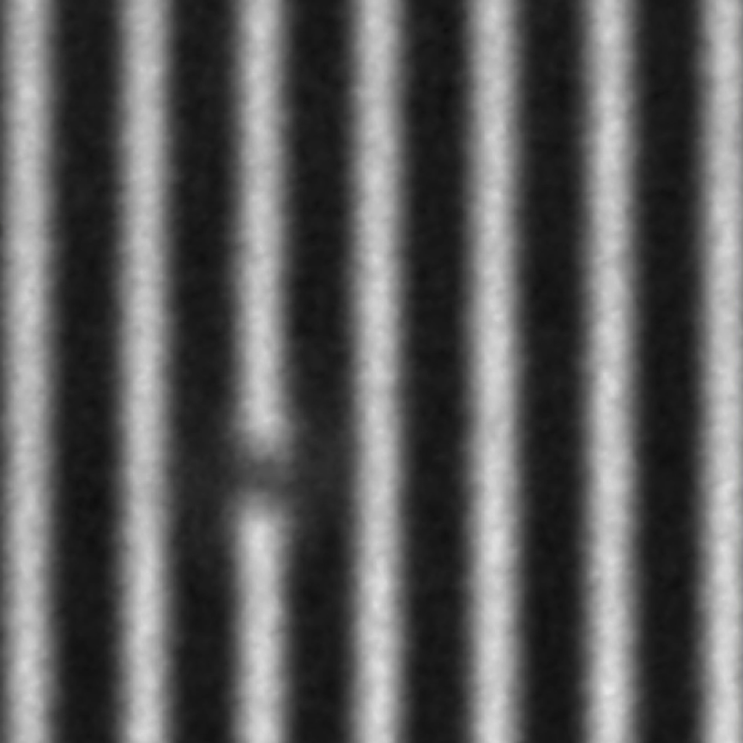
Mask inspection
SHARP
Sematech High-NA Actinic Reticle Review Project
In-focus image Out-of-focus image
Goldberg, SPIE 8679 (2013)

Slide 8
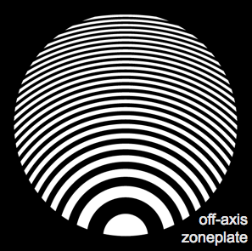
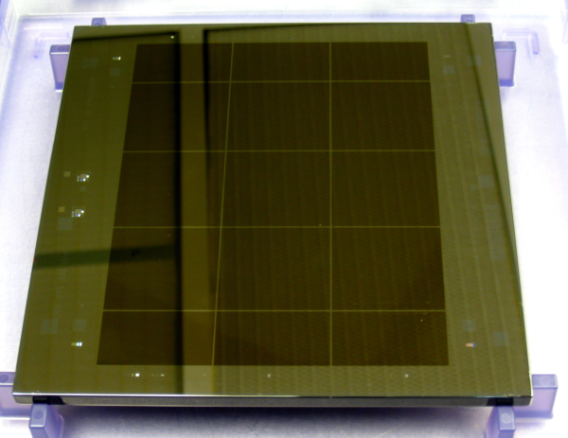
Layout
SHARP
CCD
ILLUMINATOR
LENS
PHOTOMASK

Slide 9
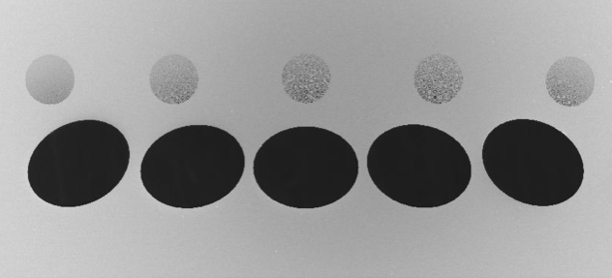
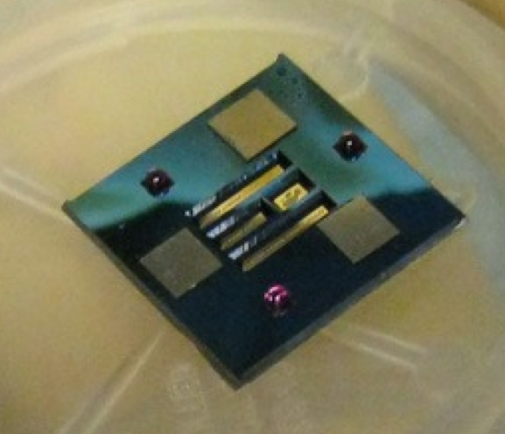
Zoneplates
SHARP
200 zoneplates
3 zoneplate chips
5 Azimuthal angles
0.0625 to 0.156 NA
6° to 10° central ray angle
160 µm
Tool performance
5 s Exposure time
8 Defect locations per hour
(160 images)
6 mm
Goldberg, SPIE 8679 (2013)

Slide 10
Spatial coherence
Fourier Synthesis Illuminator
Coherence area
Condenser

Slide 11
Spatial coherence
Fourier Synthesis Illuminator
Coherence area
Condenser

Slide 12
Spatial coherence
Fourier Synthesis Illuminator
Spatial resolution
Lens

Slide 13
Spatial coherence
Fourier Synthesis Illuminator
Spatial resolution
Lens

Slide 14
Spatial coherence
Fourier Synthesis Illuminator
NA Condenser
NA Lens

Slide 15
Pupil fill
Fourier Synthesis Illuminator
Zoneplate aperture

Slide 16
Pupil fill
Fourier Synthesis Illuminator
σ =0.25

Slide 17
Pupil fill
Fourier Synthesis Illuminator
σ =0.8

Slide 18
Pupil fill
Fourier Synthesis Illuminator
Annular fill

Slide 19
Pupil fill
Fourier Synthesis Illuminator
Dipole

Slide 20
Pupil fill
Fourier Synthesis Illuminator
Crosspole

Slide 21
Layout
Fourier Synthesis Illuminator
CCD
ILLUMINATOR
LENS
PHOTOMASK

Slide 22
Layout
Fourier Synthesis Illuminator
ILLUMINATOR

Slide 23
Layout
Fourier Synthesis Illuminator
M_{a}
4-jaw slits
M_{c}
M_{b}

Slide 24
Layout
Fourier Synthesis Illuminator
M_{a}
M_{c}
M_{b}

Slide 25
Layout
Fourier Synthesis Illuminator
M_{a}
M_{c}
M_{b}

Slide 26
Layout
Fourier Synthesis Illuminator
M_{a}
M_{c}
M_{b}

Slide 27
Layout
Fourier Synthesis Illuminator
M_{a}
M_{c}
M_{b}

Slide 28
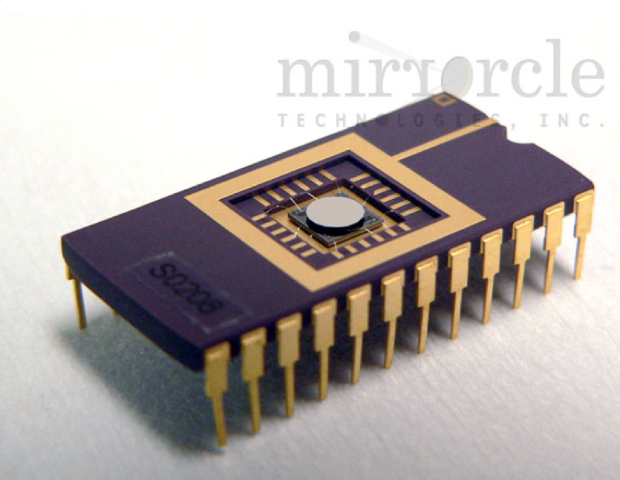
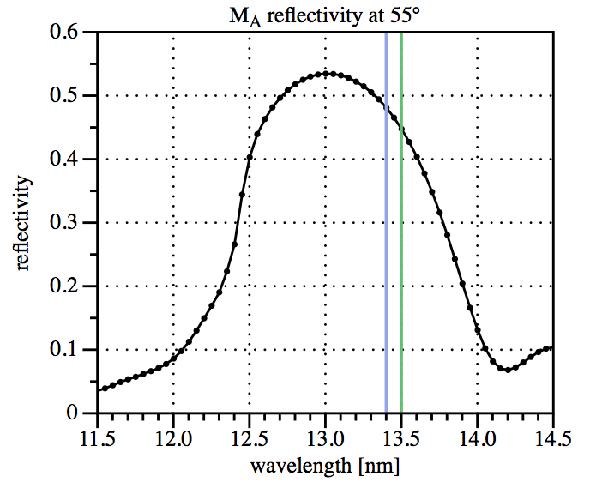
M_{a} mirror
Fourier Synthesis Illuminator
1 mm dia. flat Si substrate
1° range of incidence angles
10 bi-layer Mo/Si coating
Mirrorcle
gimbal-less dual-axis, scanning MEMS device
2 kHz scan rate
Goldberg, SPIE 8679 (2013)

Slide 29
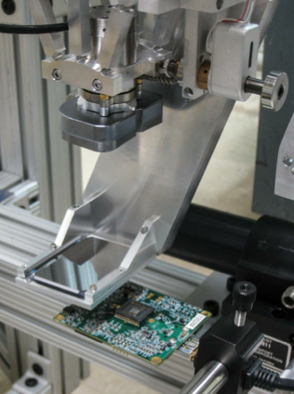
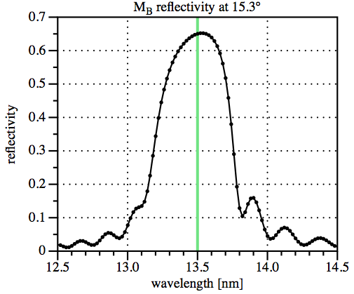
M_{b} mirror
Fourier Synthesis Illuminator
50 mm x 36 mm flat
> 2° range of inc. angles
40 Mo/Si bi-layers
Goldberg, SPIE 8679 (2013)

Slide 30
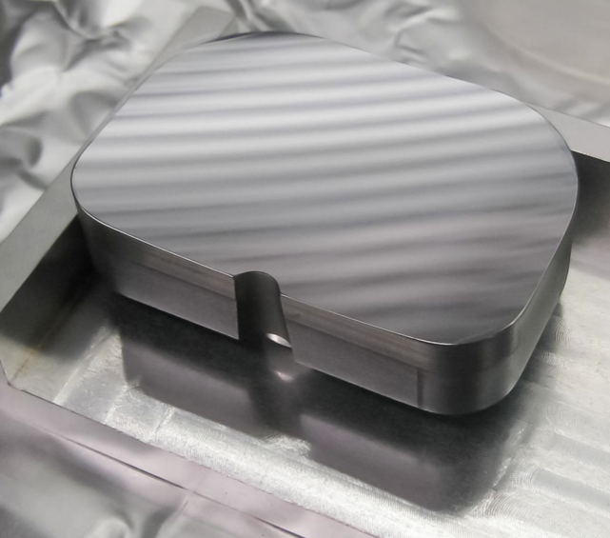
M_{c} mirror
Fourier Synthesis Illuminator
48 mm x 35 mm poly Si
ellipsoidal surface
10x demagnification
42 Mo/Si bi-layers
0.15 nm RMS roughness
<25 µrad slope error
Actuator
Piezo-driven dual-axis scanner
200 Hz scan rate
2 mrad scanning range
Goldberg, SPIE 8679 (2013)

Slide 31
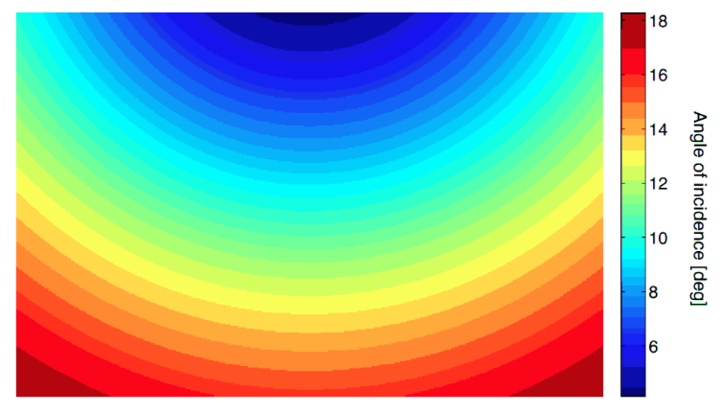
M_{c} mirror
Fourier Synthesis Illuminator
Coating
15° range of incidence angles

Slide 32
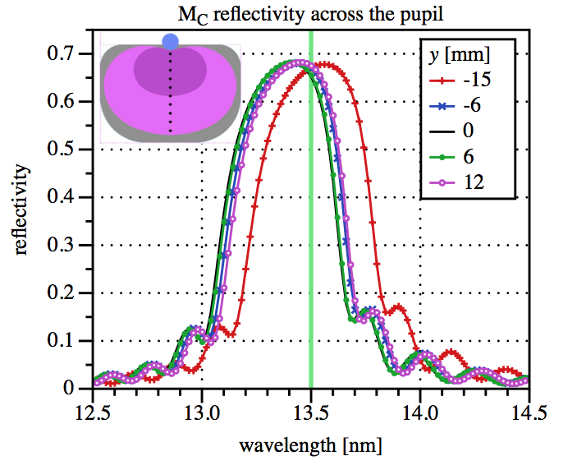
M_{c} mirror
Fourier Synthesis Illuminator
Coating
Goldberg, SPIE 8679 (2013)

Slide 33
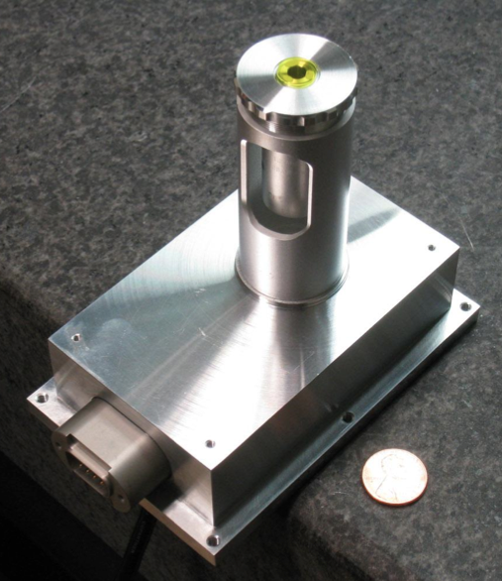
Pupil fill monitor
Fourier Synthesis Illuminator
In-vacuum YAG camera
2x magnification
2.1 µm per pixel

Slide 34
Pupil fill monitor
Fourier Synthesis Illuminator
In-vacuum YAG camera
2x magnification
2.1 µm per pixel

Slide 35
Pupil fill monitor
Fourier Synthesis Illuminator
In-vacuum YAG camera
2x magnification
2.1 µm per pixel

Slide 36
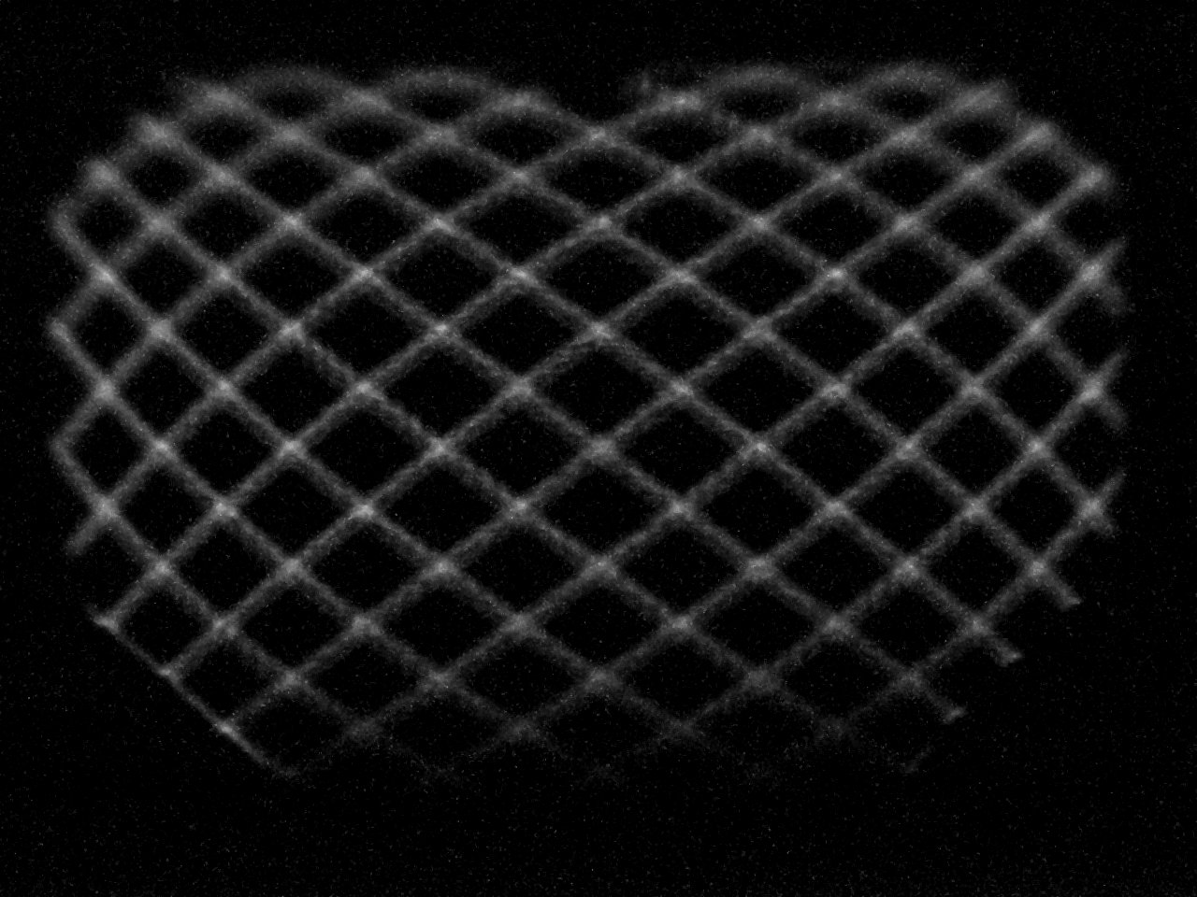
Pupil fill
Fourier Synthesis Illuminator
Lissajous pattern on M_{c} mirror

Slide 37
Pupil fill
Fourier Synthesis Illuminator
Lissajous pattern on M_{c} mirror

Slide 38
Pupil fill
Fourier Synthesis Illuminator
static beam

Slide 39
Pupil fill
Fourier Synthesis Illuminator
0.156 NA 10° CRA σ=0.8

Slide 40
Pupil fill
Fourier Synthesis Illuminator
0.156 NA 10° CRA σ=0.8 -25° azimuth

Slide 41
Pupil fill
Fourier Synthesis Illuminator
0.156 NA 10° CRA σ=0.8 +25° azimuth

Slide 42
Pupil fill
Fourier Synthesis Illuminator
0.125 NA 8° CRA σ₁=0.2 σ₂=0.8

Slide 43
Pupil fill
Fourier Synthesis Illuminator
Dipole 0.125 NA 8° CRA

Slide 44
Pupil fill
Fourier Synthesis Illuminator
Quadrupole 0.125 NA 8° CRA

Slide 45
Pupil fill
Fourier Synthesis Illuminator
Quadrupole 45° 0.125 NA 8° CRA

Slide 46
Pupil fill
Fourier Synthesis Illuminator
Crosspole 0.125 NA 8° CRA

Slide 47
Uniformity
Fourier Synthesis Illuminator
No M_{c} scanning
Image of mask blank surface σ=0.55 900x mag
5 µm

Slide 48
Uniformity
Fourier Synthesis Illuminator
Raster 8 lines 2 µm x 2 µm

Slide 49
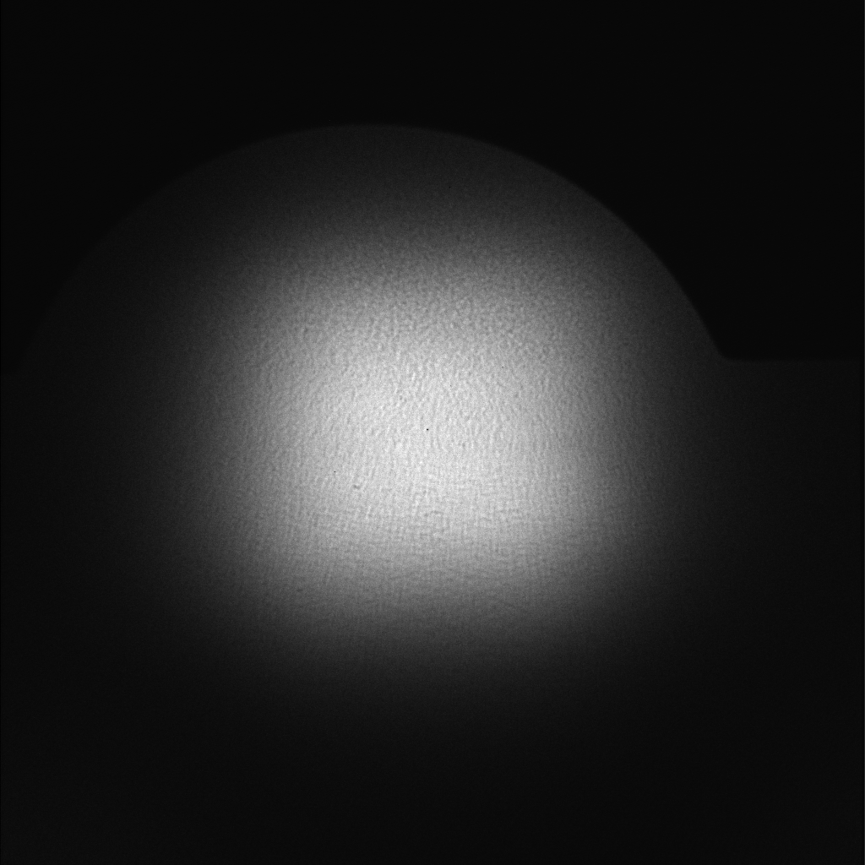
Uniformity
Fourier Synthesis Illuminator
Raster 8 lines 4 µm x 4 µm

Slide 50
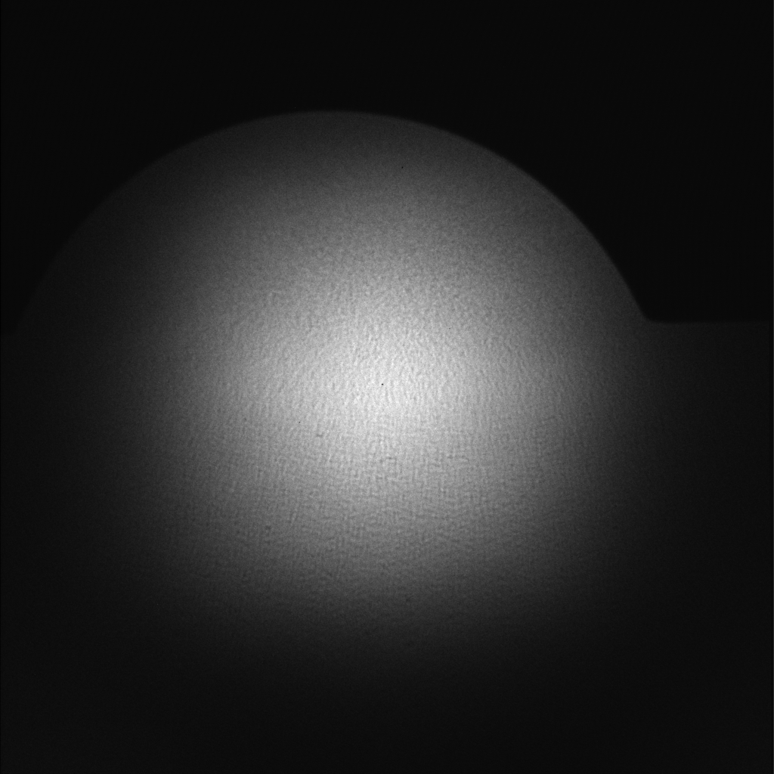
Uniformity
Fourier Synthesis Illuminator
Raster 8 lines 6 µm x 6 µm

Slide 51
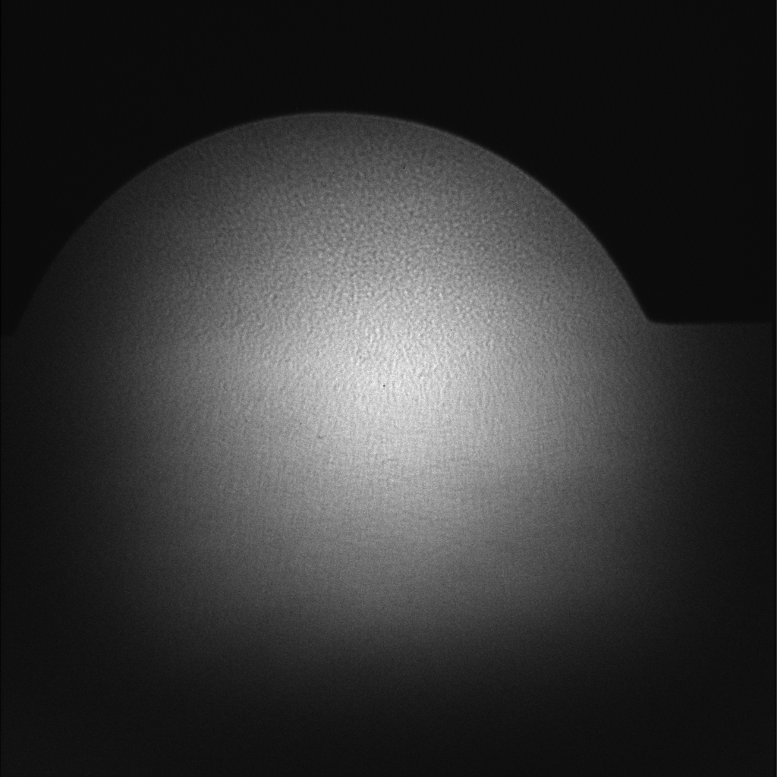
Uniformity
Fourier Synthesis Illuminator
Raster 8 lines 8 µm x 8 µm

Slide 52
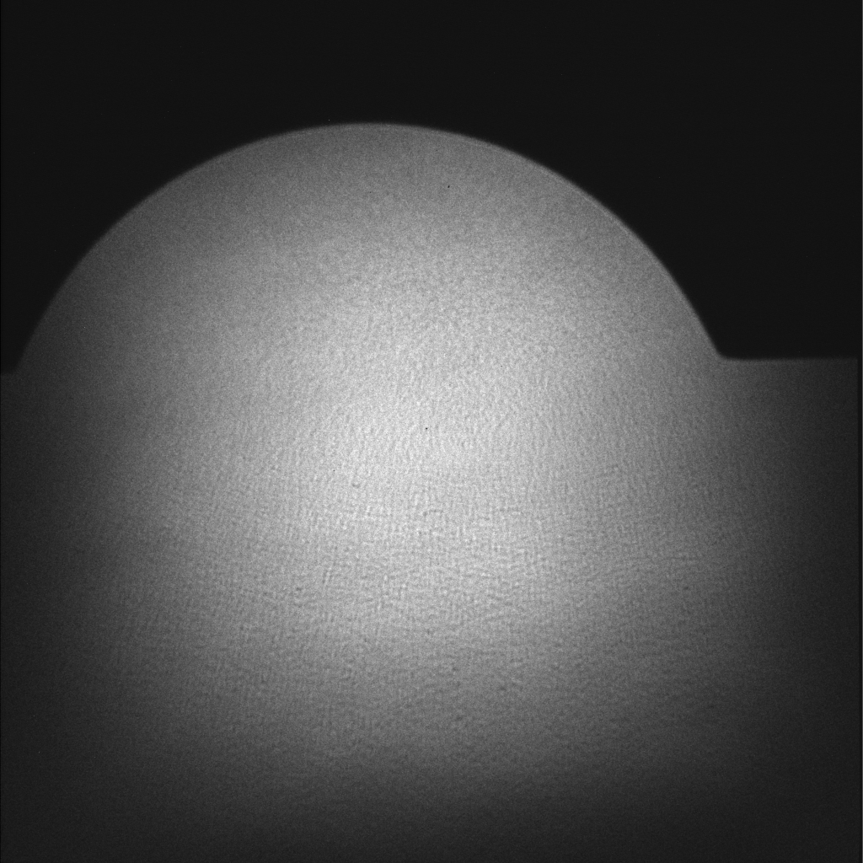
Uniformity
Fourier Synthesis Illuminator
Raster 8 lines 10 µm x 10 µm

Slide 53
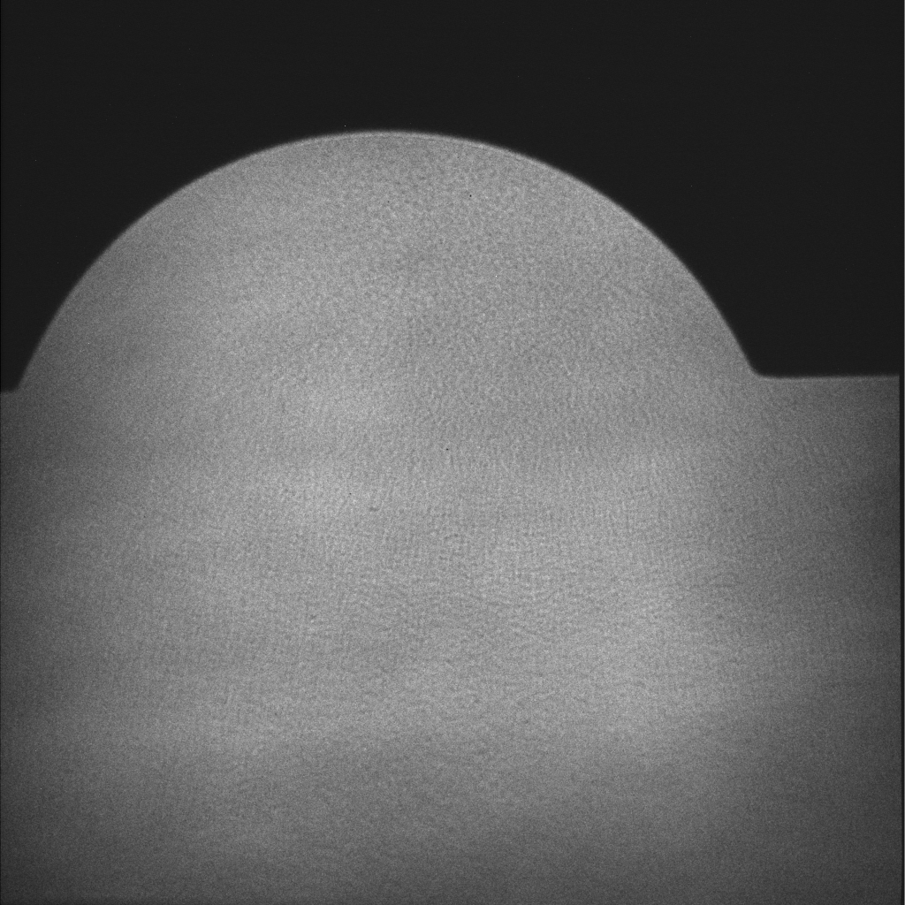
Uniformity
Fourier Synthesis Illuminator
Raster 8 lines 12 µm x 12 µm

Slide 54
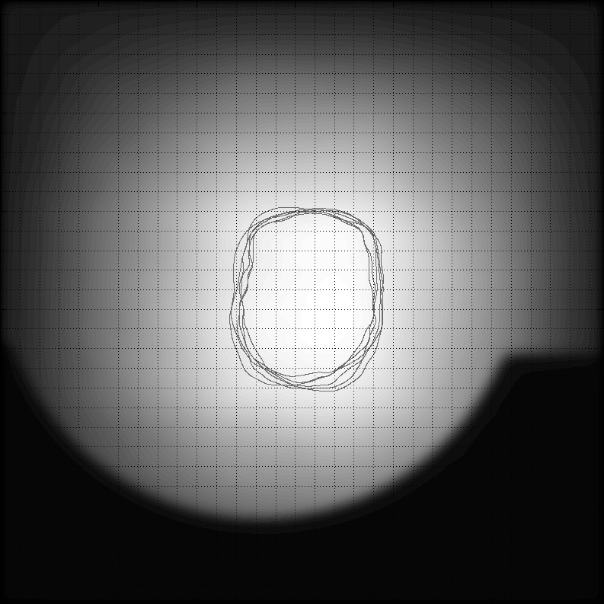
Uniformity
Fourier Synthesis Illuminator
10% Uniformity region through-focus series
2% Uniformity region single image

Slide 55
Modulation in the Image
Images
Attwood, Soft x-rays and extreme ultraviolet radiation, Cambridge University Press (1999)

Slide 56
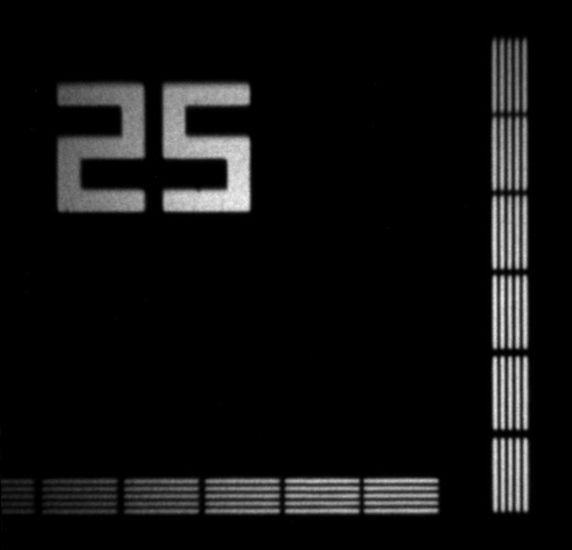
Through-focus
Images
0.0625 NA 125 nm lines and spaces
σ =1
σ ≈ 0

Slide 57
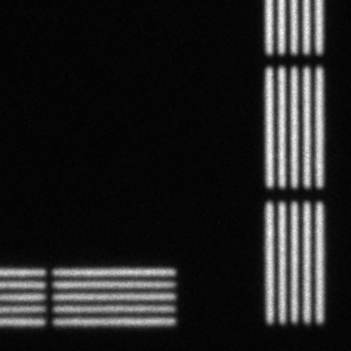
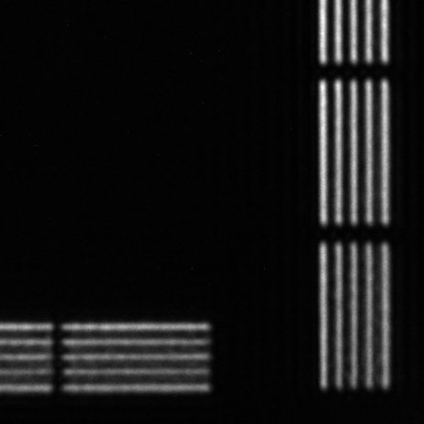
Through-focus
Images
0.0625 NA 125 nm lines and spaces
σ =1
σ ≈ 0

Slide 58
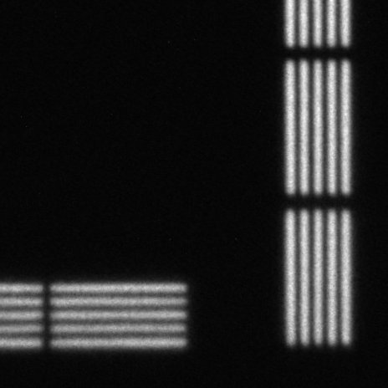
Through-focus
Images
0.0625 NA 125 nm lines and spaces
σ =1
σ ≈ 0

Slide 59
Through-focus
Images
0.0625 NA 125 nm lines and spaces
σ =1
σ ≈ 0

Slide 60
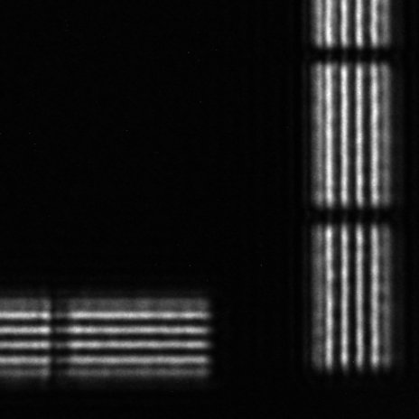
Through-focus
Images
0.0625 NA 125 nm lines and spaces
σ =1
σ ≈ 0

Slide 61
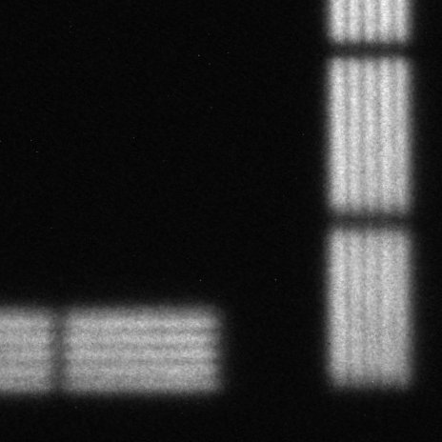
Through-focus
Images
0.0625 NA 125 nm lines and spaces
σ =1
σ ≈ 0

Slide 62
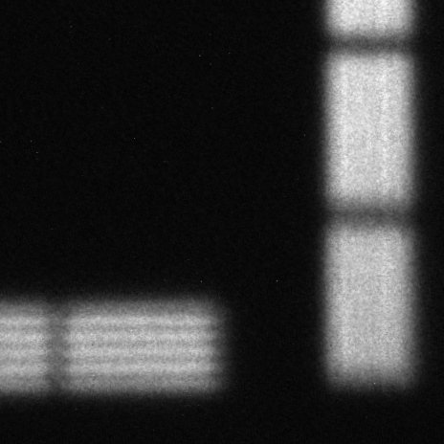
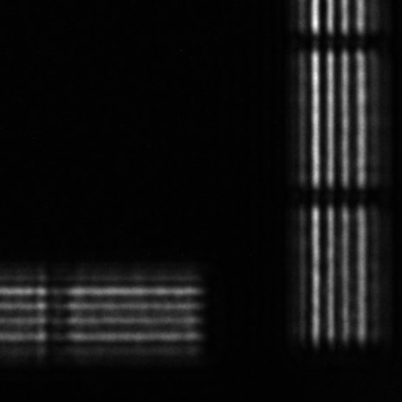
Through-focus
Images
0.0625 NA 125 nm lines and spaces
σ =1
σ ≈ 0

Slide 63
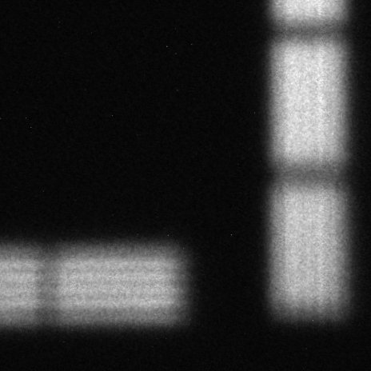
Through-focus
Images
0.0625 NA 125 nm lines and spaces
σ =1
σ ≈ 0

Slide 64
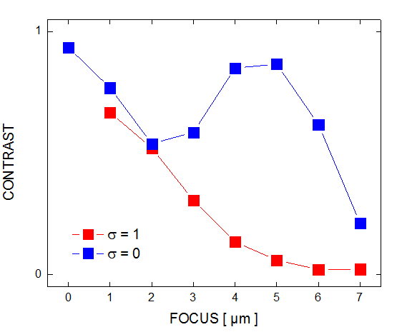
Through-focus
Images
Vertical lines

Slide 65
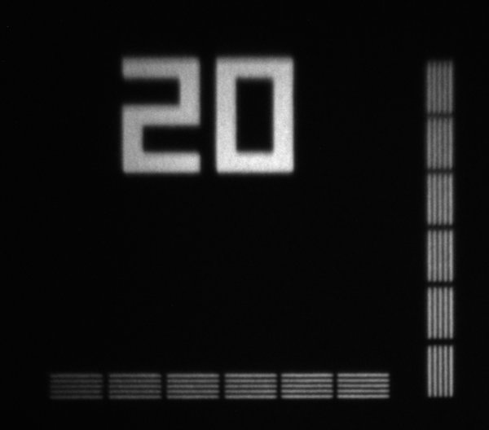
In-focus
Images
σ =1
0.0625 NA 100 nm lines and spaces

Slide 66
In-focus
Images
σ =1
0.0625 NA 100 nm lines and spaces

Slide 67
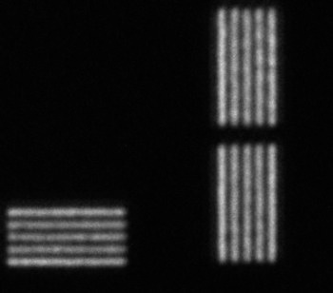
In-focus
Images
σ =0.5
0.0625 NA 100 nm lines and spaces

Slide 68
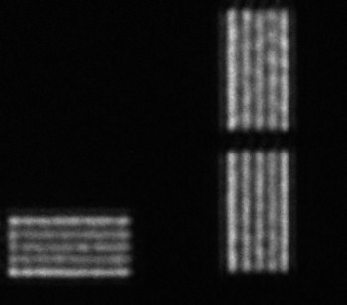
In-focus
Images
σ =0.25
0.0625 NA 100 nm lines and spaces

Slide 69
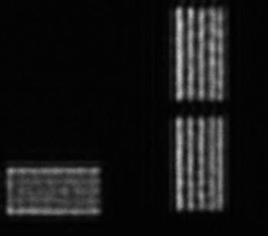
In-focus
Images
σ =0.05
0.0625 NA 100 nm lines and spaces

Slide 70
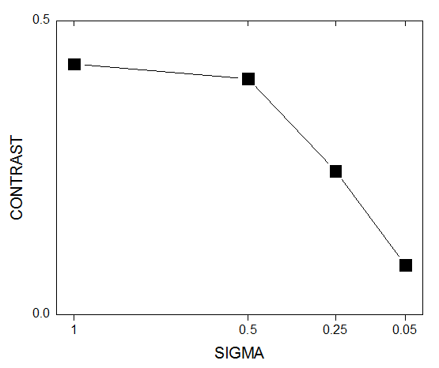
In-focus
Images
Horizontal lines
incoherent
coherent

Slide 71
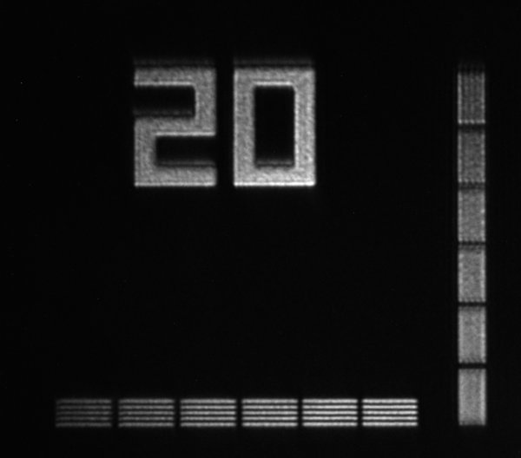
Directional pupil fill
Images
0.0625 NA 100 nm lines and spaces
Vertical dipole

Slide 72
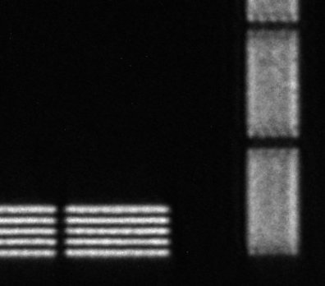
Directional pupil fill
Images
0.0625 NA 100 nm lines and spaces
Vertical dipole

Slide 73
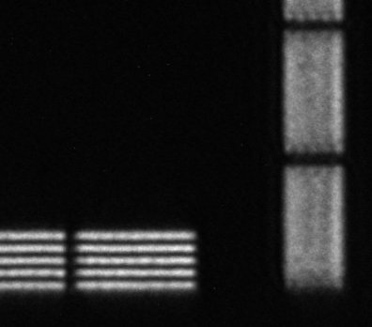
Directional pupil fill
Images
0.0625 NA 100 nm lines and spaces
Vertical dipole

Slide 74
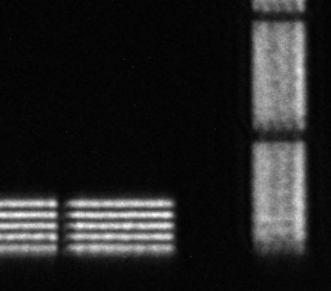
Directional pupil fill
Images
0.0625 NA 100 nm lines and spaces
Vertical dipole

Slide 75
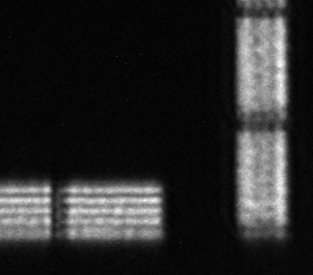
Directional pupil fill
Images
0.0625 NA 100 nm lines and spaces
Vertical dipole

Slide 76
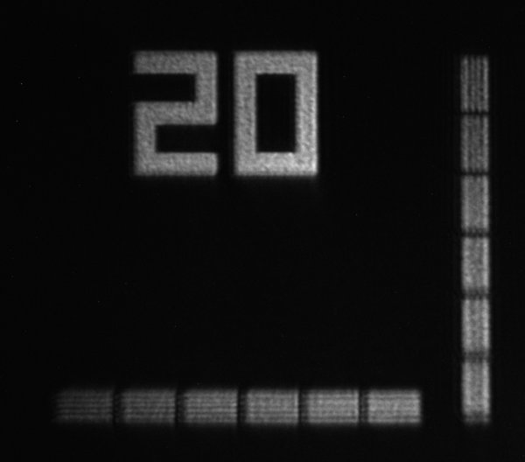
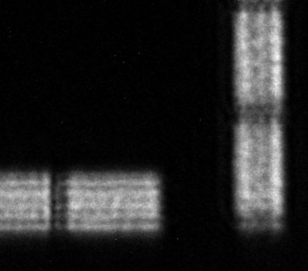
Directional pupil fill
Images
0.0625 NA 100 nm lines and spaces
Vertical dipole

Slide 77
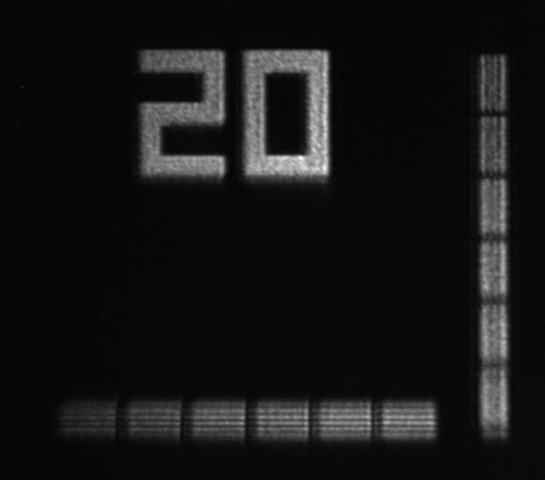
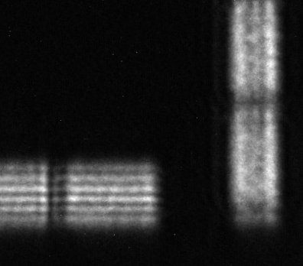
Directional pupil fill
Images
0.0625 NA 100 nm lines and spaces
Vertical dipole

Slide 78
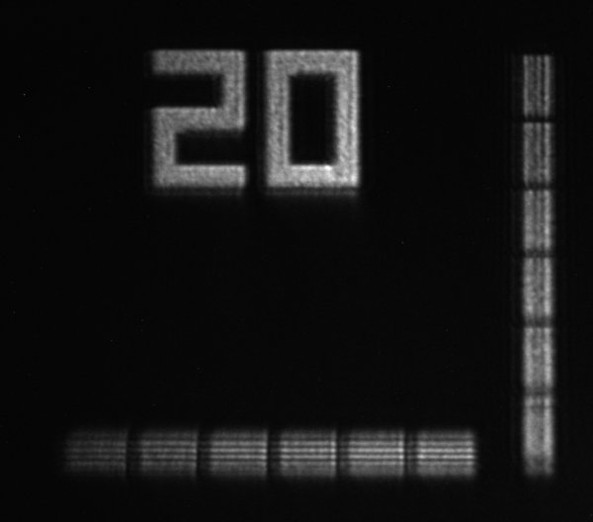
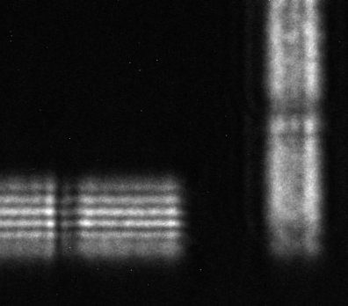
Directional pupil fill
Images
0.0625 NA 100 nm lines and spaces
Vertical dipole

Slide 79
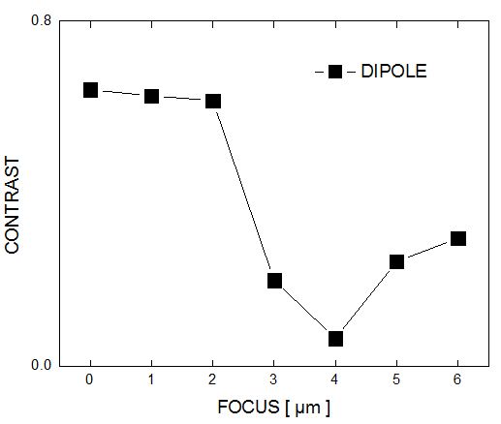
Directional coherence
Images
Horizontal lines

Slide 80
Summary
Sematech High-NA Actinic Reticle Review Project
EUV mask and pattern inspection tool
Fourier Synthesis Illuminator
Lossless control of spatial coherence and pupil fill
Scanner for uniformity control
Imaging
Influence of spatial coherence on contrast, resolution and depth-of-field
Directional pupil fill

Slide 81
Summary
Acknowledgement
This work was funded by SEMATECH through the U.S. Department of Energy under Contract No. DE-AC02-05CH11231
Thank you!

